Slide 1

From Blueprints to Flow: Designing Together
We are drafting the plans for tomorrow’s systems – together.

Slide 2


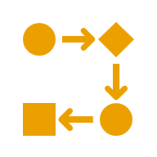

Introduction to the Blueprint and Flow Motif
Blueprint Approach
Flow Motif
Scalable Cloud Solutions
Notes:
Before we discuss patterns and architectures, I want to introduce today's guiding motif: Blueprint and Flow.
First, we have the fact that we are taking a Blueprint Approach. Just like an architect’s drawing, it’s about intentional design—laying out clear structures and plans before we build. This reminds us that serverless systems still need rigor and forethought.
Second, we are focusing on a Flow Motif. Serverless is dynamic, event‑driven, and adaptive. Flow captures that sense of movement—systems that respond in real time, scaling and shifting as needed.
Third, we are talking about building Scalable Cloud Solutions. This is where blueprint and flow come together in practice. We’re not just sketching ideas but creating systems that expand, contract, and evolve in the cloud.
These three ideas—Blueprint, Flow, and Scale—form the lens we’ll use throughout the workshop. They’re the through‑line that connects every pattern, pitfall, and case study we’ll explore.”

Slide 3




You are the Co-Architects
Shared Ownership
Active Participation
Real-World Relevance
Notes:
This workshop isn’t about us presenting and you listening. It’s about shared ownership—you’re co‑architects in this process.
We’ll encourage active participation through exercises, discussions, and design studios, where your input shapes the outcomes.
We’ll keep everything grounded in real‑world relevance. The patterns and pitfalls we explore today should relate directly to the challenges you face in your own systems.
By the end, you won’t just have heard about advanced serverless—you’ll have helped draft its blueprints.

Slide 4






Meet Your Lead Architects
Martine Dowden Andromeda Galactic Solutions CTO, UX/UI Design & Developer
Michael Dowden Andromeda Galactic Solutions Founder & Technology Leader
Chad Green Jasper Engines & Transmissions Event-Driven, Cloud-Native Systems Architect
Notes:
With all that said, let me introduce your lead architects for today.
Martine brings expertise in user experience, accessibility, and design systems—reminding us that architecture is not just about code, but about people.
Michael brings deep experience in serverless practice and thought leadership as an author and speaker.
And I’m Chad, focused on event-driven, cloud-native architectures to build scalable, compliance systems that empower business teams.
Together, we represent different disciplines, but today we’re here as a team of architects, guiding you through serverless patterns, pitfalls, and flows.

Slide 5
Meet Your Lead Architects
Martine Dowden
Michael Dowden
Chad Green
Wednesday – 14:30: Writing a dynamic API endpoint generator: Consuming arbitrary data against a user-defined layered schema
Tuesday – 11:30: Coding Serverless Functions
Wednesday – 09:00: Real-time Serverless APIs
Tuesday – 10:15: Unlock the Digital Gateway: Smarter API Discovery & Governance with Azure
Tuesday – 15:45: Scaling APIs Like the Heart of Berlin: Building Resilient APIs in Azure
Wednesday – 13:30: Ask Me Anything (AMA)

Slide 6
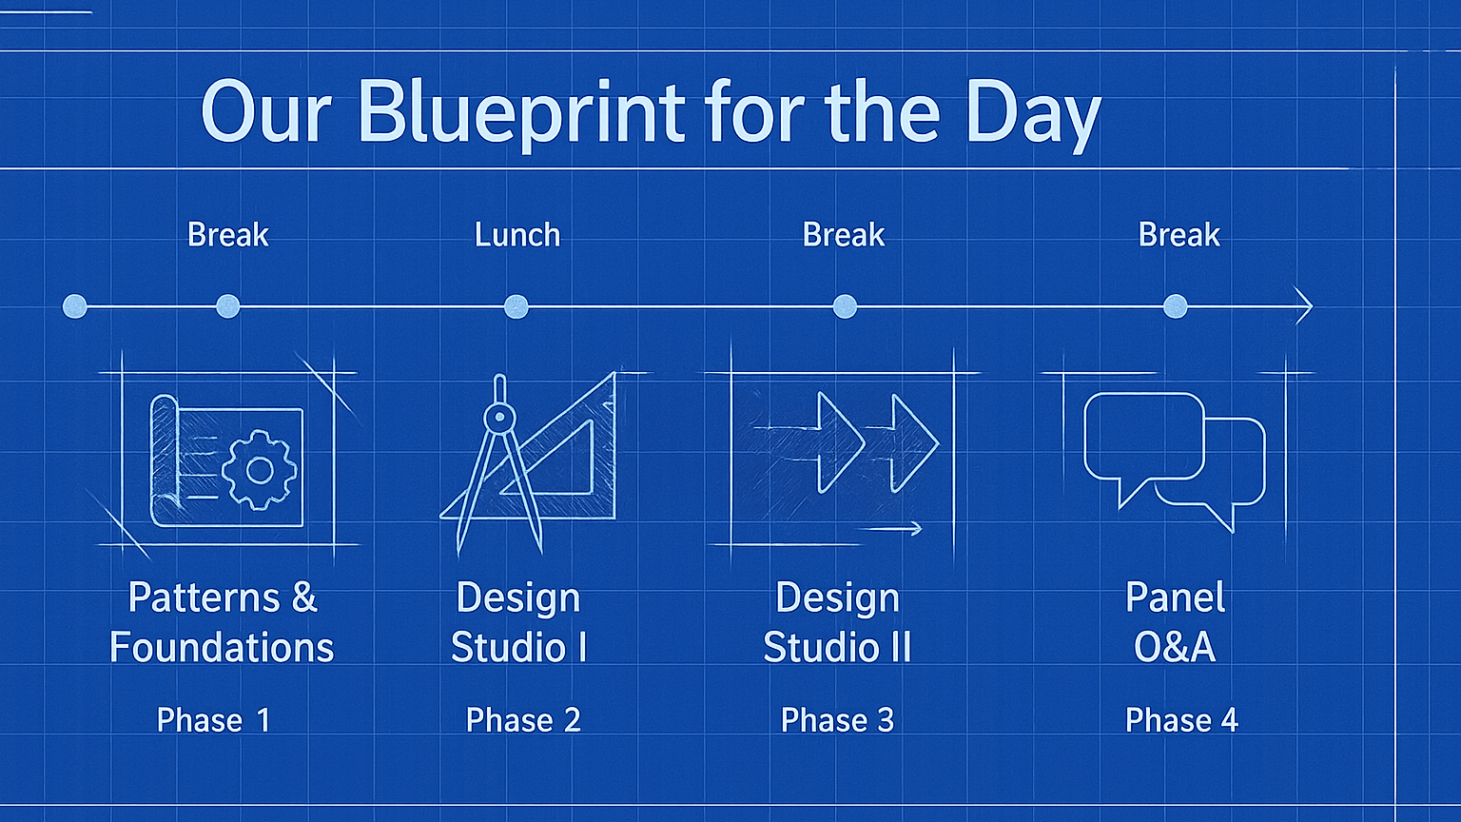
Notes:
Here’s our blueprint for the day. We’ll start with a presentation to establish patterns, pitfalls, and cross‑cutting concerns.
Then we’ll move into two design studios, where you’ll work in groups to apply what you’ve learned to real scenarios.
Finally, we’ll close with a panel Q&A, reflecting on the designs and answering your questions.
Breaks and lunch are built into the schedule, so you’ll have time to recharge.
Think of this as a construction project plan—each phase builds on the last, and by the end of the day, you’ll have your own set of serverless blueprints.

Slide 7
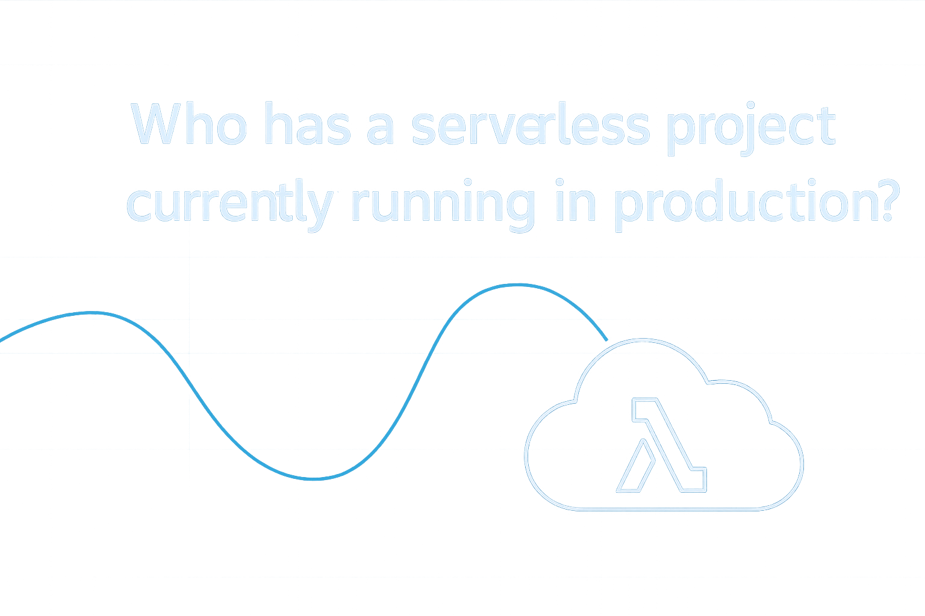
Notes:
Let’s start by getting a sense of the room. Who here already has a serverless project running in production? Go ahead and raise your hand. This helps us understand the mix of experience in the room—whether you’re already deep into serverless or just beginning to explore, your perspective will shape today’s workshop. Remember, this is our design studio, and your experiences are part of the blueprint we’ll sketch together.

Slide 8
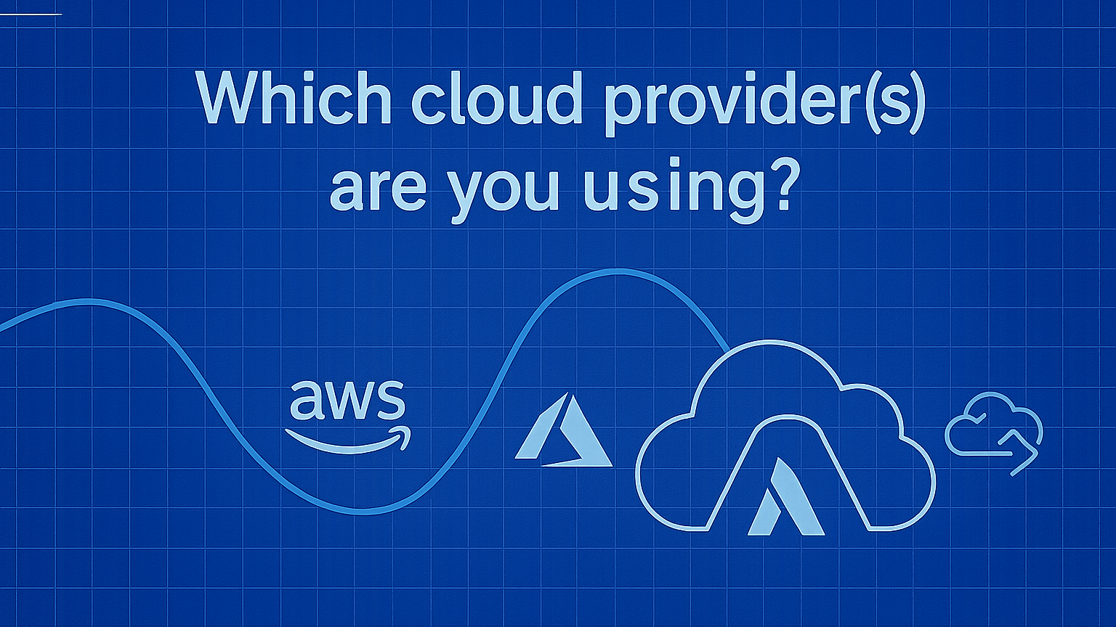
Notes:
Next, let’s get a sense of the platforms you’re working with. Who here is using AWS? Azure? GCP? Maybe more than one? This helps us understand the diversity of environments in the room. Remember, the patterns and pitfalls we’ll cover today apply across providers, but your answers will help us highlight examples that resonate with your experience.

Slide 9
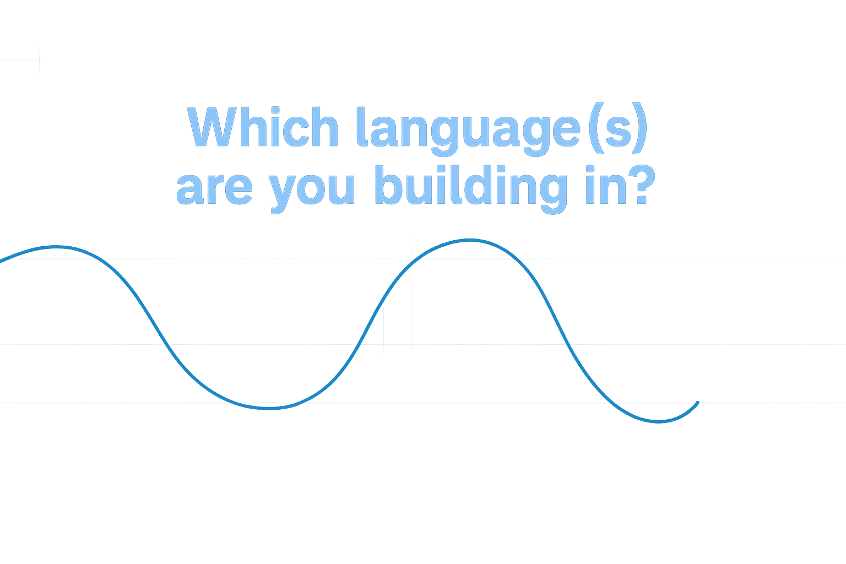
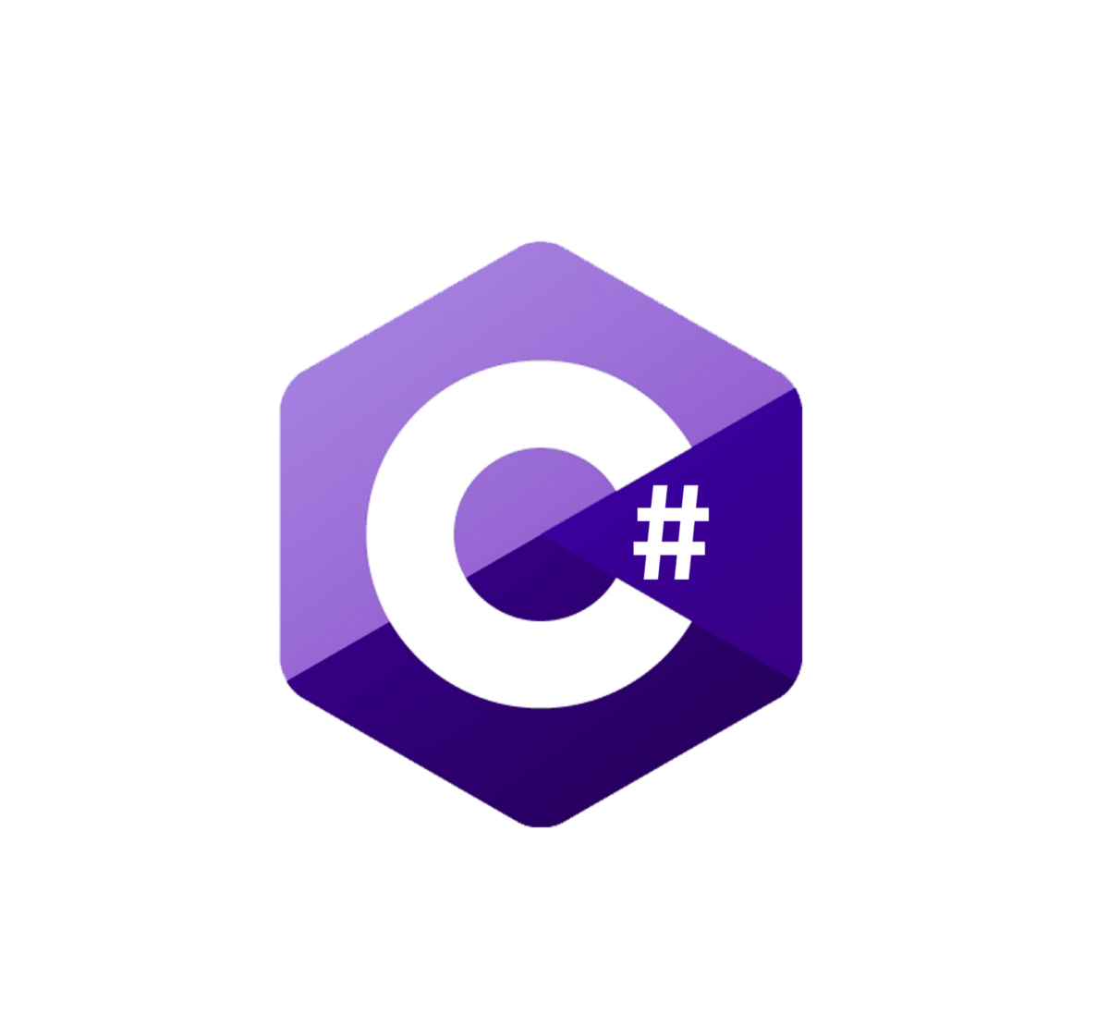



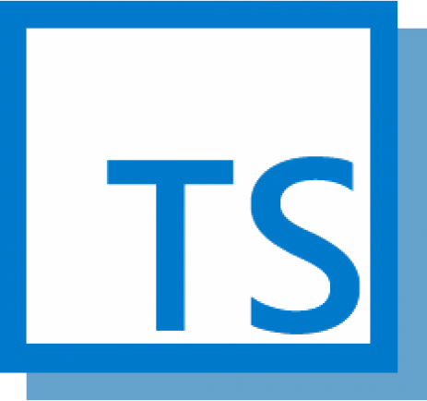


Notes:
Finally, let’s get a feel for the tech stacks in the room. Which languages are you building in? Maybe JavaScript or TypeScript? Python? C#? Java? Go? Or something else entirely? This helps us tailor examples and discussions to the languages you are working with. Whether you are building APIs, orchestrating workflows, or streaming data, your language choices shape how serverless patterns come to life.
So, raise your hand as I show the different programming languages on the screen:
C#
Java
JavaScript
Node.js
TypeScript
Python
Go

Slide 10
Why Serverless?
Notes:
Opening Framing: Before we dive into the details, let’s step back and ask the big question: Why Serverless? Why are so many organizations rethinking how they build and run applications?
Context Setting: This section is about the value proposition. We will look at how serverless changes the developer experience, how it scales, how it impacts cost, how it accelerates innovation, and why it is such a natural fit for modern architectures.
Tone/Transition: Consider this as the foundation – the “what’s in it for us” story. By the end of this section, you will see why serverless is not just a technical choice, but a strategic one.

Slide 11




Focusing on Business Logic, Not Infrastructure
Developer Productivity
Provider-Managed Infrastructure
Accelerated Delivery
Notes:
Introduction: When we talk about serverless, one of the most significant shifts is where developers spend their time and energy. Instead of worrying about servers, patches, and scaling, they can finally focus on what matters most: the business logic that drives value.
Developer Productivity: Serverless platforms free developers from the burden of infrastructure. They can concentrate on writing features and solving business problems, rather than wrestling with provisioning or maintenance. This shift dramatically improves productivity and innovation.
Provider-Managed Infrastructure: The cloud provider handles all the heavy lifting — provisioning, patching, scaling, and availability. Think of it like an architect sketching the design of a building while the construction crew handles the scaffolding and structural work. Developers stay focused on the blueprint, while the provider ensures the foundation is solid.
Accelerated Delivery: By removing infrastructure friction, teams can deliver faster. They can experiment, iterate, and push features to market more quickly. This speed is critical in today’s environment, where time-to-market often determines competitive advantage.
Metaphor: All the heaving lifting – provisioning, patching, scaling, availability – is handled by the provider. Think of it like an architect sketching the design of a building while the construction crew handles the scaffolding. The architect focuses on vision and design, while the crew ensures the structure stands.
Closing Transition: So, when we say, “focus on business logic, not infrastructure,” we are talking about unlocking developer creativity, relying on providers for the undifferentiated heavy lifting, and accelerating delivery cycles. This is the function of why serverless matters.

Slide 12




Elastic, Event-Driven Scaling
Event-Driven Triggers
Instant Scaling Capability
Ideal for Variable Workloads
Notes:
Introduction: One of the most powerful aspects of serverless is its scale. Instead of provisioning for peak demand, the system responds dynamically to events as they happen.
Event-Driven Triggers: Scaling is initiated by events — whether a new order, a file upload, or a sensor reading. The system reacts automatically without human intervention.
Instant Scaling Capability: Serverless platforms expand instantly from a single to millions. There is no waiting for servers to spin up or clusters to resize — it just happens.
Ideal for Variable Workloads: This makes serverless perfect for unpredictable or bursty workloads.
Metaphor: Think of it like an expandable bridge: as traffic increases, it extends seamlessly to handle the load, then contracts when demand drops.
Closing Transition: So instead of designing for the worst-case scenario, serverless lets us design for the real world — elastic, event-driven, and efficient.

Slide 13




Cost Efficiency
Pay Only for Usage
Elimination of Idle Costs
Budget Management
Notes:
One of the most tangible benefits of serverless is cost efficiency. Instead of paying for capacity you might never use, costs are tied directly to actual consumption.
Pay Only for Usage: With serverless, you are billed only for the execution time and resources consumed. If your function runs for 300 milliseconds, you pay for exactly that — nothing more.
Elimination of Idle Costs: There is no need to keep servers running just in case. Idle capacity and over-provisioning disappear, which means no wasted spend.
Budget Management: This model makes financial planning easier. Costs scale with usage, so budgets align naturally with business activity, giving finance teams more predictability.
Metaphor: Think of it like your home electricity bill. You do not pay for the power plan; you pay for the kilowatt-hours you actualy use. Serverless brings that same utility-meter model to computing.
Closing Transition: This efficiency not only reduces waste but also ensures that engineering and finance are aligned — every dollar spent is tired to real business value.

Slide 14




Faster Innovation Cycles
Remove Infrastructure Barriers
Accelerated Iteration & Experimentation
Quicker Product Development
Notes:
Introduction: One of the biggest promises of serverless is how it accelerates innovation. By removing infrastructure friction, teams can move from idea to execution much faster.
Remove Infrastructure Barriers: Developers no longer wait for servers to be provisioned or environments to be configured. That barrier is gone, which means less downtime and fewer bottlenecks.
Accelerated Iteration & Experimentation: Serverless makes it easy to experiment. Teams can test new features quickly, learn from results, and refine ideas without heavy upfront investment.
Quicker Product Development: This speed translates directly into faster delivery. Concepts move from whiteboard sketches to production-ready products in record time.
Think of it like rapid prototyping in architecture — sketching, testing, and refining designs until the final blueprint emerges. Serverless enables the same iterative rhythm in software.
Closing Transition: Serverless is not just about cost or scale but also about enabling a culture of experimentation and faster innovation cycles.

Slide 15



Built for Modern Architectures
Microservices Ready
Event-Driven by Design
DevOps Integration
Notes:
Introduction: Serverless is not just a cost or scaling story; it is designed for the way we build modern systems today.
Microservices Ready: Serverless naturally complements microservices. Each function is small, independent, and can scale on its own. This modularity makes systems easier to evolve.
Event-Driven by Design: Serverless thrives in event-driven systems. Functions respond instantly to triggers; whether that is a user action, a file upload, or a sensor reading; with minimal latency.
DevOps Integration: Serverless fits seamlessly into modern DevOps practices. Functions can be deployed continuously, tested quickly, and rolled back easily, aligning perfectly with CI/CD pipelines.
Metaphor: Think of it like modular building blocks snapping together. Each piece is independent, but together they forma flexible, scalble structure that can adapt as needs change.

Slide 16
Why Now?
Notes:
Opening Framing: Of course, it is important to understand why serverless is valuable. But the next question is just as important: Why now? Why is this the right moment for organizations to embrace serverless?
Context Setting: In this section, we will explore the drivers behind today’s adoption: the maturity of the platforms, the fact that serverless has gone mainstream, the economic pressures pushing up toward efficiency, and the growing demand for developer productivity.
Tone/Transition: This is where we connect the dots between the technology and the timing. Serverless is not just a good idea – it is an idea whose moment has arrived.

Slide 17

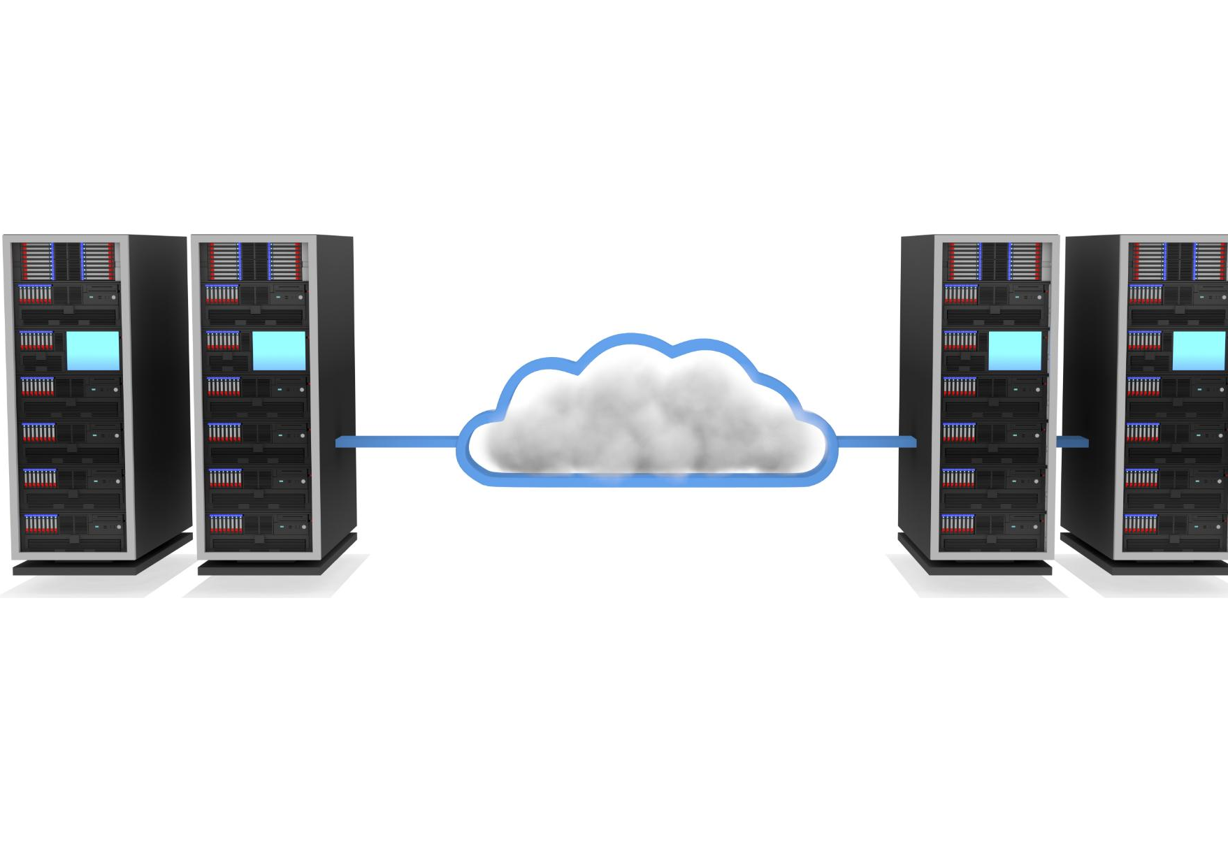


Maturity of Platforms
Extended Runtimes
Advanced Monitoring
Richer Integrations
Notes:
Introduction: Serverless is not new anymore, but what has changed is the maturity of the platforms themselves. What started as lightweight, experimental runtimes has evolved into enterprise-ready systems.
Extended Runtimes: Functions can now run longer and handle more complex workloads, opening the door to use cases that were not possible in the early days.
Advanced Monitoring: Providers now offer detailed monitoring and observability: metrics tracing, and logging that meet enterprise standards for reliability.
Richer Integrations: Serverless platforms integrate with a wide range of services, such as databases, messaging, and AI/ML pipelines, making it easier to build sophisticated workflows.
Metaphor: Think of it like architectural blueprints. Early drafts were rough sketches, but today’s platforms are production-grade designs, ready to support mission-critical workloads.
Closing Transition: This maturity is why serverless is no longer just an experiment – it is a proven foundation for modern enterprise systems.

Slide 18


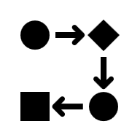

Mainstream Adoption
APIs at Scale
ML & Data Pipelines
Enterprise Integration
Notes:
Introduction: Serverless has moved beyond experimentation. It is no longer niche – it is powering critical systems across industries.
APIs at Scale: Many organizations now run their APIs on serverless platforms. It provides instant scalability and cost efficiency, making it a natural fit for backend services.
ML & Data Pipelines: Serverless is also used in machine learning and analytics pipelines. It can process data flexibly and scale with demand, essential for AI workloads.
Enterprise Integration: Serverless has become part of the mainstream IT landscape. It is not just startups—enterprises are using it for production workloads and integrating it into their core systems.
Metaphor: Think of a city skyline. At first, serverless was a small building on the edge. Today, it is part of the skyline – a permanent fixture in modern technology.
Closing Transition: This mainstream adoption shows that serverless is not just a trend but a proven approach shaping how organizations build and scale systems.

Slide 19



Economic Pressures
Economic Uncertainty
Cost-Efficient Solutions
Serverless Optimization
Notes:
Introduction: Economic pressure is one of the strongest drivers for serverless adoption. Organizations everywhere are asked to do more with less.
Economic Uncertainty: In today’s climate, cost optimization is not optional but a survival strategy. Businesses need to reduce waste and maximize efficiency.
Cost-Efficient Solutions: Traditional infrastructure often means paying for idle capacity. Serverless flips that model with pay-per-use pricing, so you only pay for what you consume.
Serverless Optimization: This makes serverless a natural fit for cost-conscious organizations. It aligns spending directly with business activity, ensuring costs scale with demand.
Metaphor: Think of it like an energy grid. Instead of running your own generator 24/7, you draw exactly the power you need, when you need it – no waste, no idle costs.
Closing Transition: In a world of economic uncertainty, serverless offers a model that is both efficient and sustainable.

Slide 20




Developer Productivity Demands
Faster Time-to-Market
Focus on Features
Accelerated Velocity
Notes:
Introduction: Organizations today face relentless pressure to deliver faster. Customers expect rapid updates, and competitors are moving quickly. That puts developer productivity at the center of the conversation.
Faster Time-to-Market: Speed is no longer optional. Teams are expected to release features and products at a pace that keeps them competitive.
Focus on Features: Serverless helps by removing infrastructure overhead. Developers can focus on writing business logic and delivering value instead of patching servers or managing environments.
Accelerated Velocity: This shift accelerates development cycles. Teams can experiment, iterate, and innovate continuously, without being slowed down by infrastructure fiction.
Metaphor: Think of it like eco-friendly building design, where every element is optimized for efficient energy flow. Serverless creates that same kind of efficiency for developers, ensuring their energy goes into features and not wasted effort.
Closing Transition: Developer productivity demands are another reason serverless adoption is accelerating now—it enables teams to move faster, focus on value, and innovate continuously.

Slide 21
Conclusion
Operational Simplicity
Serverless computing reduces complexity by removing infrastructure management tasks, enabling focus on development.
Scalability Benefits
Serverless platforms automatically scale applications based on demand without manual intervention.
Cost Efficiency
Pay-as-you-go pricing models reduce costs by charging only for actual resource usage.
Faster Innovation
Developers can rapidly build and deploy features, accelerating time to market with serverless architectures.
Notes:
Serverless computing delivers key benefits such as operational simplicity, scalability, cost savings, and faster innovation. Coupled with maturing platforms and pressing economic needs, now is the perfect time for organizations to embrace modern cloud-native architectures with serverless.

Slide 22
Serverless Architecture Styles
Notes:
Opening Framing: Now that we have explored why serverless matters and why now is the right moment, let’s shift gears into the how. Specifically, let's discuss how serverless architectures are actually applied in practice.
Context Setting: Serverless doesn’t fit in just one architecture style; it complements many different styles. Each one solves other problems, first handles different workloads, and has its own strengths and trade-offs. Understanding these styles helps us choose the right approach for the right scenario.
Preview of What’s Ahead: In this section, we will look at five of the most common patterns:
Event-Driven Architectures
Microservices with Functions-as-a-Service
Orchestration and Workflow Design
Data Processing Pipelines
Hybrid or Polyglot Architectures
Tone/Transition: Think of this section like a blueprint catalog. Each style is a different design option – and by the end, you’ll have a toolkit of patterns you can apply to your own systems.

Slide 23

Event-Driven Architectures
Serverless Function Triggers
In event-driven architectures, functions respond to triggers such as HTTP requests, database changes, or file uploads.
Scalable Reactive Systems
Event-driven models support scalable and reactive systems by leveraging flexible and elastic pipelines.
Circuit Diagram Metaphor
Events are visualized as sparks in a circuit diagram, igniting flows within the architecture.
Avoiding Anti-Patterns
Avoid one function handling too many event types to maintain clarity and ease of maintenance.
Notes:
Introduction: Event-driven architectures are the heartbeat of serverless. Functions do not sit idle – they wake up when something happens.
Serverless Function Triggers: These events can come from anywhere: an HTTP request, a database update, a file upload, or an IoT sensor. Each event sparks a function into action.
Scalable Reactive Systems: This model is inherently elastic. The system scales automatically as events increase, making it ideal for real-time pipelines and reactive systems.
Circuit Diagram Metaphor: Think of it like a circuit diagram. Each event is a spark that lights up a relay, triggering the next flow. It’s a clean, modular way to visualize how events drive action.
Avoiding Anti-Patterns: One caution: do not overlap a single function with too many event types. That creates tangled logic and makes debugging painful. Keep functions focused and modular.
Closing Transition: Event-driven design is the foundation of serverless – simple, reactive, and infinitely scalable.

Slide 24
Microservices with FaaS
Discrete Single-Responsibility Functions
Microservices built as single, independent functions enable clear modular division and responsibility separation.
Independent Scaling and Modularity
FaaS supports independent scaling of functions, similar to rooms in a building connected by API gateways.
Mini-Monolith Anti-Pattern
Avoid sharing excessive state or logic between functions to prevent the mini-monolith anti-pattern.
Notes:
Introduction: Serverless and microservices are a natural fit. Functions act as the smallest building blocks, each with a single responsibility.
Discrete Single-Responsibility Functions: Each function should do one thing well—like a room in a building serving a specific purpose. This keeps the architecture clean and modular.
Independent Scaling and Modularity: Because independent functions can scale separately. One function might handle thousands of requests per second, while another stays idle – which is fine.
Metaphor: Think of it like a building plan. Each room has a clear purpose, and the hallways – your API Gateway – connect them together. This makes it easy to expand or remodel without tearing down the whole structure.
Mini-Monolith Anti-Pattern: The danger is creating “mini-monoliths” —functions that share too much state or logic. That defeats the purpose of modularity and makes scaling harder. Keep functions small, focused, and loosely coupled.
Closing Transition: Microservices with FaaS give us modularity, flexibility, and scalability – but only if we respect the boundaries and avoid slipping back into monolithic habits.

Slide 25
Orchestration and Workflow Patterns
Serverless Orchestration Tools
Tools like Step Functions and Durable Functions manage workflows, ideal for long-running and auditable processes.
Control Tower Metaphor
The control tower metaphor illustrates central coordination and management of multiple subsystems via a master plan.
Avoiding Unnecessary Complexity
Orchestration should be avoided for simple tasks to prevent overhead and maintain clear system logic.
Notes:
Introduction: Sometimes, functions do not just run independently but must work together in a coordinated sequence. That is where orchestration comes in.
Coordinated Functions: Tools like Step Functions or Durable Functions act as state machines, managing the flow between functions. They handle retries, branching, and state, so you do not have to hard-code everything.
When to Use: This is ideal for long-running, stateful, or auditable processes – things like order fulfillment, approval workflows, or multi-step business processes.
Metaphor: Think of it like an airport control tower. Each plane—or function—has its own job, but the tower coordinates everything to ensure smooth, safe operations. That’s orchestration in action.
Avoiding Unnecessary Complexity: One caution: don’t use orchestration for trivial tasks. It adds overhead and complexity where a simple event trigger would do. Save orchestration for processes that ruely need it.
Closing Transition: Orchestration allows us to design reliable, auditable workflows – but only when applied thoughtfully.

Slide 26
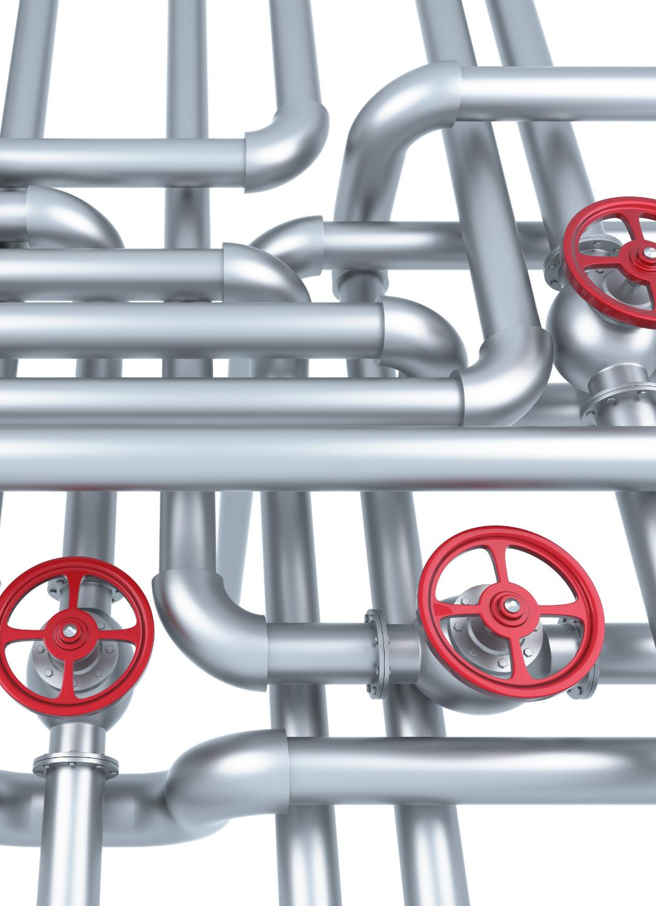
Data Processing Pipelines
Serverless Pipeline Concept
Serverless pipelines chain functions to process ETL, analytics, or IoT data efficiently in stages.
Real-Time Applications
This pattern supports real-time dashboards and dynamic data transformation for timely insights.
Limitations of Over-Chaining
Excessive chaining leads to latency, debugging challenges, and fragile, hard-to-maintain pipelines.
Notes:
Introduction: Serverless is not just about APIs or workflows—it is also a powerful fit for data. One of the most common architectural styles is the data processing pipeline.
Chained Functions: In this model, functions are chained together to transform, enrich, and route data. Each function is a stage in the pipeline, handling one process step.
When to Use: This is ideal for ETL, analytics, IoT ingestion, or powering real-time dashboards. It is about moving data quickly from raw input to actionable insight.
Anti-Pattern Watch: The danger is over-chaining. Too many small functions in sequence can add latency, making debugging harder, and create fragile pipelines. Keep the flow efficient and balanced.
Closing Transition: Data pipelines show how serverless can handle high-volume, real-time data – but only if we design them with simplicity and resilience.

Slide 27
Hybrid / Polyglot Serverless
Blending Serverless and Legacy
Hybrid architectures combine serverless functions with containers, VMs, and legacy systems to support flexible, mixed workloads efficiently.
Workloads and Task Matching
Use serverless functions for bursty, stateless tasks and containers or VMs for long-running, stateful jobs within the same architecture.
Avoid Architectural Fragmentation
Uncontrolled serverless adoption without proper integration can lead to fragmented, inefficient architectures. Strategic planning ensures cohesion.
Notes:
Introduction: Not every workload fits neatly into serverless. That is why hybrid and polyglot architectures are so important.
Blended Environments: In this model, serverless functions coexist with containers, VMs, or legacy systems, each technology leveraging its strengths.
When to Use: Use serverless for bursty, stateless, event-driven tasks. Use containers or VMs for long-running, stateful, or specialized processing. Together, they create a balanced architecture.
Metaphor: Think of it like a building with extension wings. The main structure is your core system, and serverless acts as a modular add-on – flexible, lightweight, and easy to expand without redesigning the whole building.
Anti-Pattern Watch: The risk is treating serverless as a bolt-on without governance. That leads to fragmented, hard-to-manage systems. Integration and standards are key to making hybrid work.
Closing Transition: Hybrid and polyglot architectures remind us that serverless is not an all-or-nothing choice – it is a powerful complement to our existing systems.

Slide 28
Core Serverless Patterns
Notes:
Opening Transition: We have just looked at the big picture – the architectural styles that shape how serverless fits into modern systems. Now it is time to zoom in.
Context Setting: Architectural styles give us the blueprint, but patterns are the building blocks. These are the recurring solutions we see again and again in real systems – the practical ways teams implement serverless in production.
Framing the Section: In this section, we will explore the core serverless patterns that underpin those larger styles. Each pattern has a clear event flow, a guiding metaphor to make it memorable, and a diagram to help us visualize how it works.
Tone/Transition: Think of this as moving from the city map down to the street level. We are going from broad design choices to the specific routes and interactions that make serverless architectures run.
Closing Setup: By the end of this section, you will not only recognize these patterns, but also know when to apply them – and when to avoid the anti-patterns that can creep in.

Slide 29



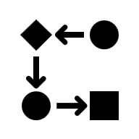
Foundational Request/Response
Core Serverless Pattern
The request/response pattern forms the foundation of serverless architectures with API Gateway and Function integration.
Direct Client Interaction
It handles client requests directly and returns immediate responses, serving as the system’s front door.
Simple Event Flow
The event flow is straightforward: request enters, function executes, then response is sent back.
Notes:
Introduction: Starting with the most fundamental category of serverless patterns – request/response. It is simple, but it underpins almost everything else we will cover.
Core Idea: In this pattern, a client sends a request, a function executes, and a response is returned. That is it. It is the cleanest expression of serverless: no servers to manage, just code that runs when needed.
Why It Matters: Even though it is the “hello world” of serverless, it is still critical. Most serverless systems start here because it provides a direct, predictable way to handle client interactions.
Metaphor: Think of it as the front door into your system. Every request comes through this entry point, gets processed, and exits with a response. It is the simplest way to visualize how users interact with serverless applications.
Event Flow: The flow is straightforward: request in → function executes → response out. That simplicity makes it easy to understand, teach, and extend into more advanced patterns.
Closing Transition: This request/response foundation is where serverless begins. On the next slide, we will zoom in on one of the most common implementations of this patter – using an API Gateway to manage those requests.

Slide 30

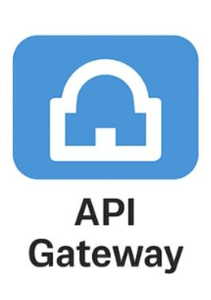
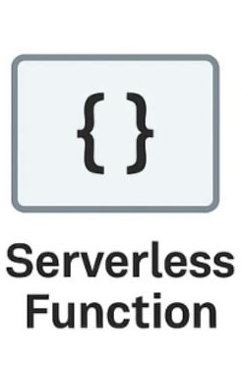
API Gateway Pattern
Notes:
Introduction: This is the most common way the foundational request/response pattern is implemented in serverless – through an API Gateway.
Step 1 — Client Request: A client, whether a web app, mobile app, or other service, sends a request. That request does not go directly to a function—it first passes through the API Gateway.
Step 2 — API Gateway Role: The API Gateway is the front door. It authenticates, authorizes, validates, and routes requests. It can also handle cross-cutting concerns like throttling, caching, or logging.
Step 3 — Function Execution: Once the request is validated, the gateway invokes the serverless function. The function executes the business logic – whether that is fetching data, processing input, or triggering downstream services.
Step 4 — Response Path: The function returns a response back to the API Gateway, which then delivers it to the client. The gateway ensures consistency in how responses are formatted and delivered.
Metaphor: Think of the API Gateway as the doorman of a building. It checks who you are, decides where you should go, and then lets you in. The function is the room where the actual work happens.
Closing Transition: This pattern is simple but powerful. It is the backbone of most serverless APIs, and it sets the stage for more advanced event-driven and data-centric patterns we will explore next.

Slide 31
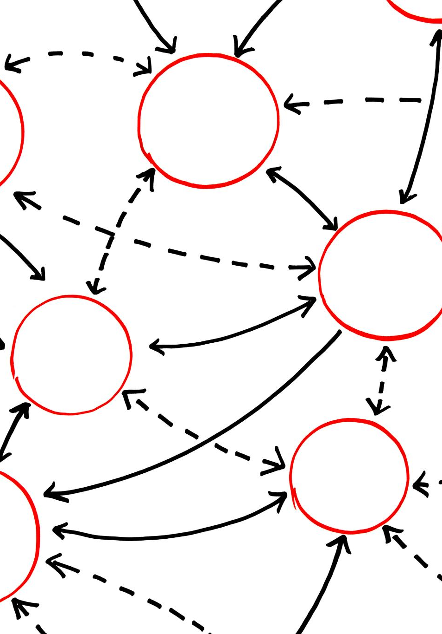



Event-Driven Core Patterns
Decoupling Producers and Consumers
Event-driven processing separates producers and consumers, improving system flexibility and scalability.
Pub/Sub Pattern
Pub/Sub pattern acts like a signal relay, distributing events to multiple subscribers efficiently.
Fan-Out/Fan-In Pattern
Fan-Out/Fan-In pattern enables branching event streams and parallel workers aggregating results.
Notes:
Introduction: Now that we have seen the foundational request/response model, let’s move into the heart of serverless: event-driven patterns. These are what make serverless architectures reactive, scalable, and flexible.
Decoupling Producers and Consumers: The first principle is decoupling. Producers generate events without knowing who will consume them. This separation gives us flexibility and scalability – systems can evolve independently.
Pub/Sub Pattern: One way to achieve this is with the Publish/Subscribe pattern. Think of it like a signal relay: a single event can be broadcast to many subscribers, each reacting in their own way.
Fan-Out/Fan-In Pattern: Another is Fan-Out/Fan-In. Here, one event fans out to multiple workers in parallel, and their results are later merged. It is like a distribution manifold in plumbing—splitting into many pipes and then recombining them.
Closing Transition: These core patterns are the backbone of event-driven design. Next, we will zoom in on Pub/Sub and Fan-Out/Fan-In individually, with diagrams to show exactly how they work.

Slide 32



Publish/Subscribe (Pub/Sub)
Notes:
Introduction: The Publisher/Subscribe pattern is one of serverless's most common event-driven designs. It is about decoupling producers from consumers.
Step 1 — Producer Publishes: A producer – maybe an app, a service, or even a sensor – generates an event. Instead of sending it directly to a function, it publishes it to a central topic or event bus.
Step 2 — Event Bus Role: The event bus acts like a signal relay. It does not care who produced the event or who will consume it. Its job is to broadcast the event to anyone who is subscribed.
Step 3 — Multiple Subscribers: Subscribers – often serverless functions –receive the event independently. One might update a database, another might send a notification, and another might trigger analytics. They do not know about each other, and they do not need to.
Metaphor: Think of it like a radio broadcast. The producer is the station, the event bus is the antenna, and subscribers are radios tuned in. Everyone hears the same signal, but each listener can react differently.
Closing Transition: This pattern gives us flexibility and scalability. Producers and consumers evolve independently, and we can add new subscribers without changing the producer. Next, we will look at the Fan-Out/Fan-In, which builds on the idea by adding parallelism and aggregation.

Slide 33

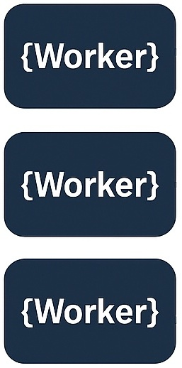

Fan-Out / Fan-In
Notes:
Introduction: The Fan-Out/Fan-In pattern is about parallelism and aggregation. It is one of the most powerful ways to scale serverless workloads.
Step 1 — Fan-Out: A single event triggers multiple functions in parallel. Each worker handles a slice of the work, such as processing a batch of records, resizing an image, or running a calculation.
Step 2 — Parallel Workers: These workers run independently, which means the system can scale horizontally. If you have one event that needs 100 tasks, you can spin up 100 workers at once.
Step 3 — Fan-In (Aggregation): Once the workers finish, their results are collected by an aggregator function. This function merges the outputs into a single result, like combining partial calculations into a final answer.
Metaphor: This of it like plumbing: one pipeline splits into many smaller pipes to distribute water, then they rejoin into a single pipeline downstream. Fan-Out/Fan-In works the same way with data and computation.
Closing Transition: This pattern is ideal for workloads that benefit form parallelism – but it is important to design the aggregation step carefully, since it can become a bottleneck. Next, we will look at how this pattern fits into real-world event-driven systems.

Slide 34




Migration & Evolution Strategies
Strangler Fig Pattern
This pattern incrementally migrates legacy systems by gradually wrapping old components with new interfaces.
Incremental Migration
Incremental wrapping allows smooth transition and reduces risks during system modernization.
Event Flow Rerouting
Event flow diagrams illustrate traffic rerouting over time for controlled and safe modernization.
Notes:
Introduction: Most of us do not get to start with a blank slate. Migration and evolution are about modernizing existing systems without disrupting the business.
Strangler Fig Pattern: One of the most effective strategies is the Strangler Fig pattern. Like the tree growing around its host, we wrap legacy systems with new serverless interfaces and gradually replace the old parts.
Incremental Migration: This is about scaffolding – building around the existing structure. Instead of a risk big-bang rewrite, we migrate piece by piece, reducing risk and keeping the system running as we modernize.
Event Flow Rerouting: As we replace components, we route traffic. Requests that once went to the legacy system are redirected to new serverless functions. Over time, more and more traffic flows through the modern path until the old system can be retired.
Closing Transition: These strategies give us a safe, controlled way to evolve. Next, we will zoom in on the Stranger Fig pattern itself – the most widely used approach for incremental migration.

Slide 35
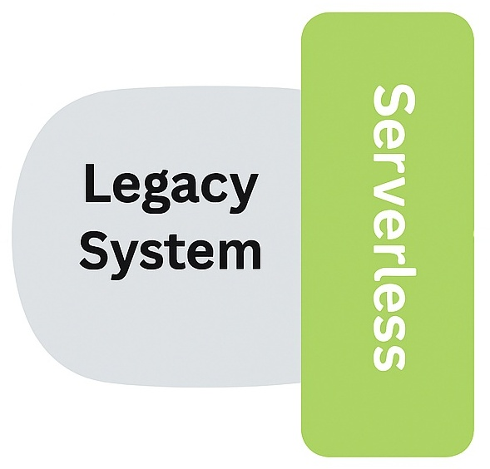
Strangler Fig
Request
Request
Notes:
Introduction: The Strangler Fig pattern is one of the most practical ways to modernize legacy systems without a risky big-bang rewrite.
Step 1 – Legacy System: Initially, all requests flow into the legacy system. It is stable, but often hard to change or scale.
Step 2 — Wrapping with Serverless: New serverless functions are introduced as a wrapper around the legacy system. They start by handling small, well-defined pieces of functionality.
Step 3 — Gradual Rerouting: Over time, more requests are rerouted to the serverless layer. The legacy system handles less and less traffic as its responsibilities shrink.
Step 4 — Eventual Retirement: Eventually, the legacy system can be retired altogether, leaving only the modern, serverless architecture in place.
Metaphor: Just like the strangler fig tree grows around its host, eventually replacing it, this pattern lets us grow a new system around the old one until the old system is no longer needed.
Closing Transition: This approach minimizes risk, keeps the system running during migration, and gives teams the flexibility to modernize at their own pace.

Slide 36





Data-Centric Patterns
Event Sourcing
Event Sourcing treats every data change as an immutable event, similar to a ledger or revision log.
CQRS Architecture
CQRS separates command and query pipelines to improve system scalability and performance.
Data Lake Integration
Data Lake Integration uses serverless technologies for efficient data ingestion and transformation.
Notes:
Introduction: Serverless is not just about compute but also how we manage and process data. Data-centric patterns help us handle state, history, and analytics at scale.
Event Sourcing: With Event Sourcing, every change is recorded as an immutable event. Think of it like a ledger or revision log – nothing is overwritten, everything is preserved. This gives us a perfect audit trail and the ability to rebuild a state at any time.
CQRS Architecture: CQRS, or Command Query Responsibility Segregation, separates the write and read paths. Commands update the state, while queries read optimized views. This separation improves scalability and performance, especially in high-traffic systems.
Data Lake Integration: Finally, Data Lake Integration leverages serverless for ingestion and transformation. Think of it as a reservoir where raw data flows in, and serverless functions act like filters and pumps, preparing it for analytics and machine learning.
Closing Transition: These patterns give us the tools to manage data as a first-class concern in serverless systems. Next, we will dive deeper into Event Sourcing, CQRS, and Data Lake individually, with diagrams to show how they work in practice.

Slide 37
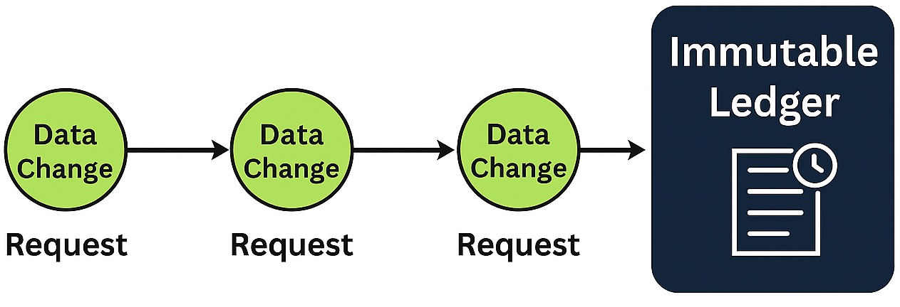
Event Sourcing
Notes:
Introduction: Event Sourcing is a data-centric pattern that treats every change as an immutable event. Instead of overwriting state, we record a sequence of events that describe how the system got to its current state.
Step 1 — Commands: A client issues a command – for example, “place order” or “update profile”. This command is handled by a serverless function.
Step 2 — Event Store: Instead of directly updating a database, the function appends an event to an immutable event store. Think of it like a ledger or revision log – every change is written down, nothing is lost.
Step 3 — State Rebuilder: When we need the current state, we replay the sequence of events. A state rebuilder processes the event history and reconstructs the latest view.
Step 4 — Benefits: This gives us a perfect audit trail, the ability to debug by replaying history, and the flexibility to project the same events into multiple views. – for example, analytics, dashboards, or machine learning pipelines.
Metaphor: Think of it like a checkbook ledger. You do not just look at the current balance – you can see every deposit and withdrawal that led to it. Event Sourcing works the same way with system state.
Closing Transition: This pattern is foundational for event-driven systems. Next, we will look at CQRS, which often pairs with Event Sourcing to separate the write and read paths for scalability.

Slide 38
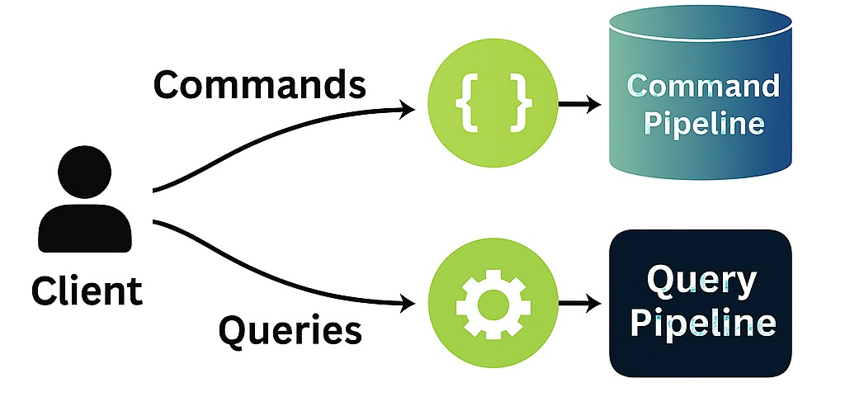
Command Query Responsibility Segregation (CQRS)
Notes:
Introduction: CQRS stands for Command Query Responsibility Segregation/ It is a mouthful, but the idea is simple: separate the write and read paths.
Step 1 – Commands (Write Path): When a client issues a command – like “place order” or “update profile” – it is handled by a serverless function dedicated to writes. That function updates the write model, which is optimized for transactions and consistency.
Step 2—Queries (Read Path): Queries—like “show my order history”—are handled by a different serverless function. Instead of hitting the transactional store, it reads from a read model that is optimized for fast lookups and reporting.
Why It Fits Serverless: This separation maps beautifully to serverless. Each function is small, single-purpose, and event-driven. Write functions scale independently of read functions, and each can use the best storage option for its workload—for example, DynamoDB for writes and ElasticSearch or a cache for reads.
Benefits: By splitting reads and writes, we reduce contention, improve scalability, and allow each side to evolve independently. This is critical for performance in high-traffic systems.
Metaphor: Think of it like a restaurant. The kitchen staff (commands) handle orders and update the system, while the wait staff (queries) serve customers quickly from a prepared menu. Each side has its own workflow, but they deliver a smooth experience together.
Closing Transition: CQRS often pairs with Event Sourcing, where the write side records immutable events and the read side builds optimized views. Together, they form a robust foundation for serverless data-centric design.

Slide 39
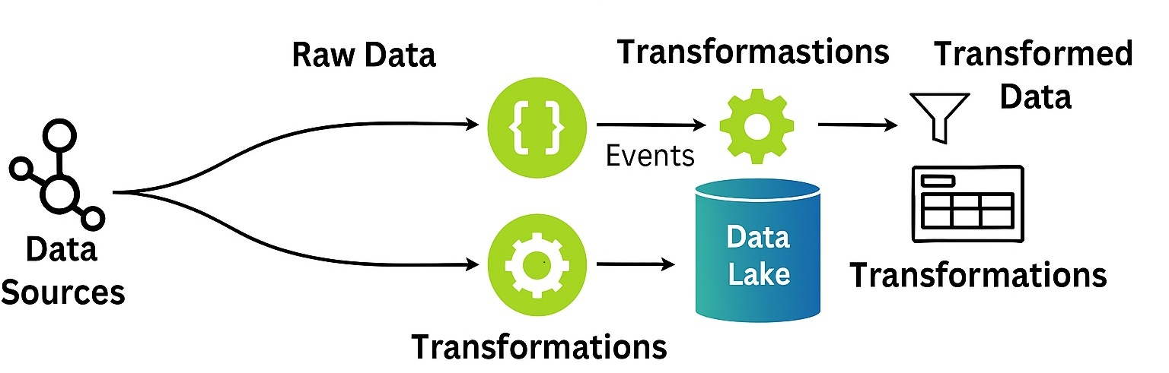
Data Lake Integration
Notes:
Introduction: Data Lake Integration is about centralizing raw data and using serverless to process and refine it. This pattern is compelling when dealing with diverse, high-volume data sources.
Step 1—Ingestion: Raw data flows in from multiple sources, such as IoT devices, logs, applications, or external feeds. Instead of running permanent ETL servers, we use serverless ingestion functions that trigger automatically when new data arrives.
Step 2 – Storage in the Data Lake: All of that raw data lands in a Data Lake. It’s schema-on-read, meaning we do not force structure up front. This gives us flexibility to decide later how we want to use it.
Step 3—Transformation: Serverless functions then act like filters and pumps. They are triggered by events, like a new file landing in the lake, and they transform, clean, or enrich the data. Because they are event-driven, they only run when needed.
Step 4 – Outputs: The refined data can feed analytics dashboards, machine learning models, or downstream applications. Each consumer gets the data in the shape they need.
Why It Fits Serverless: This pattern is a natural fit for serverless because ingestion and transformation are inherently event-driven. Functions scale elastically, spinning up only when there is data to process. That means lower costs, less operational overhead, and near-infinite scalability.
Metaphor: Think of Data Lake as a reservoir. Raw water flows in from many streams. Serverless functions are the treatment plant – filtering, purifying, and channeling that water into useful streams.
Closing Transition: By decupling ingestion from transformation, Data Lake integration gives us a flexible, scalable way to manage data at rest and in motion.

Slide 40



Time & Coordination Patterns
Time-Based Triggers
Schedulers and cron-like triggers initiate automated functions at precise time intervals for consistent execution.
Coordinated Workflows
Orchestration patterns use workflow diagrams or control towers to manage multi-step automated processes efficiently.
Robust Operations
Retries and compensations in workflows ensure resilient and reliable automation processes.
Notes:
Introduction: Serverless is not just about responding to events—it is also about coordinating tasks over time. Time and coordination patterns let us automate processes with precision and reliability.
Time-Based Triggers: Schedulers or cron-like triggers initiate functions at exact intervals. This is perfect for tasks like nightly data processing, hourly reporting, or daily clean-ups. Think of it as a serverless alarm clock.
Coordinated Workflows: Some processes require multiple steps in sequence or parallel. Orchestration patterns – often called workflow-as-code – let us define these steps, manage dependencies, and ensure everything runs in the right order.
Robust Operations: Real-world automation needs resilience. Retries handle transient failures, while compensations roll back or adjust when something goes wrong. Together, they make workflows reliable and production-ready.
Closing Transition: These patterns give us the tools to automate with confidence. Next, we will zoom in on two of the most common: scheduler/cron triggers and orchestration workflows.

Slide 41
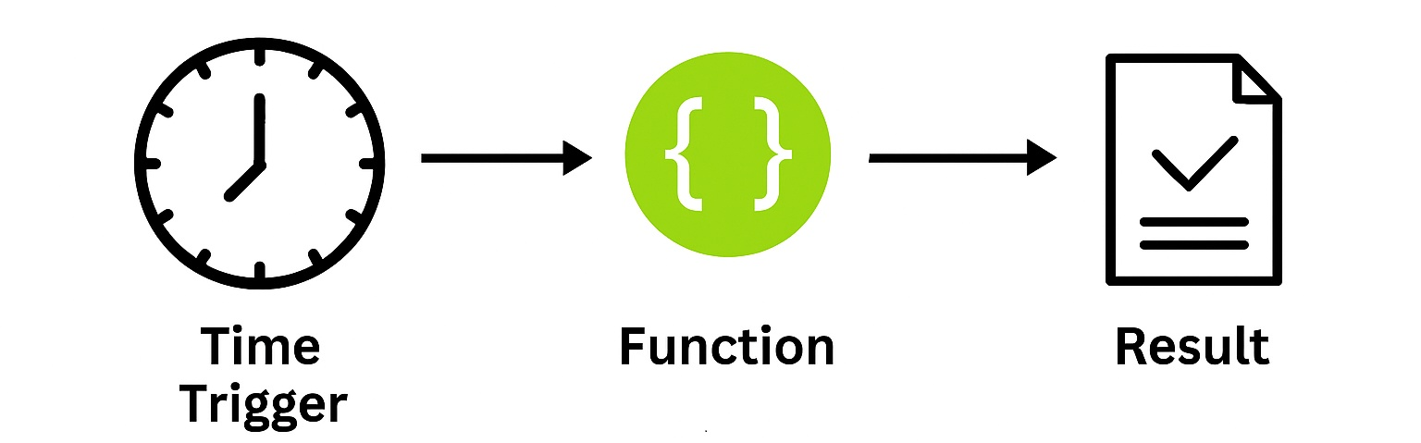
Scheduler/Cron
Notes:
Introduction: The scheduler, or Cron pattern, is one of the simplest but most powerful serverless patterns. It allows us to run functions at precise intervals without managing any servers or cron daemons ourselves.
Step 1 – Time Trigger: A time-based trigger – like a cron express or scheduled rule – fires at a specific interval. This could be ever minute, very hour, or once a day at midnight.
Step 2 – Function Execution: When the trigger fires, it invokes a serverless function. That function contains the logic for the task we want to automate – for example, cleaning up old records, generating a daily report, or sending notifications.
Step 3 – Task Output: The function produces a result – whether that is updating a database, sending an email, or writing a file. The key is that it happens automatically, on schedule, without human intervention.
Why It Fits Serverless: This pattern is a natural fit for serverless because we do not need to keep a server running to wait for the clock to tick. Functions only run when scheduled, so we pay for execution time, not idle time. It is efficient, cost-effective, and scales seamlessly.
Metaphor: Think of it like an alarm clock for your architecture. Instead of waking you up, it wakes up a function exactly when needed.
Closing Transition: This pattern is perfect for recurring jobs and maintenance tasks. Next, we will look at orchestration patterns, which take automation further by coordinating multi-step workflows.

Slide 42
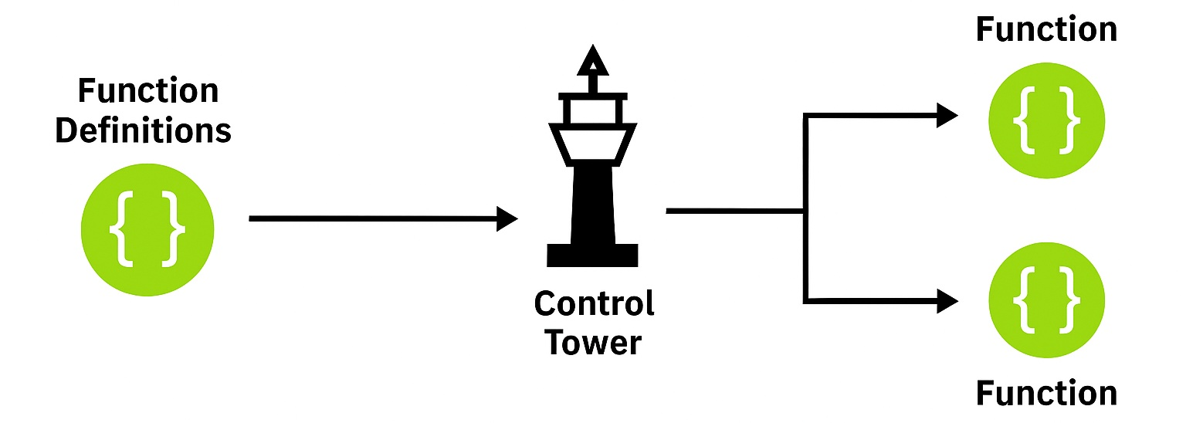
Orchestration (Workflow-as-Code)
Notes:
Introduction: Some processes are too complex for a single function. They require multiple steps, decisions, and error handling. That is where orchestration – or workflow as code – comes in.
Step 1 – Orchestrator: The orchestrator acts like a control tower. It does not do the work, but coordinates which serverless functions run, in what order, and under what conditions.
Step 2—Workflow Steps: Each step is a serverless function that can run sequentially or in parallel. For example, one function might validate input, another might process payment, and another might send a notification.
Step 3—Decisions and Branching: The orchestrator can include decision points. Based on the outcome of one step, it can branch into different paths, such as approving or rejecting a request.
Step 4—Robustness: Workflows also include retries and compensations. If a step fails, the orchestrator can retry it or trigger a compensation action to roll back changes. This makes the system resilient and reliable.
Why It Fits Serverless: This pattern is a natural fit for serverless because each step is a small, event-driven function. The orchestrator stitches them together without requiring us to manage servers or long-running processes. It scales automatically, and we only pay for the running steps.
Metaphor: Think of orchestration like an air traffic control tower. The tower doesn’t fly the planes but ensures every plane takes off, lands, and routes safely. In the same way, the orchestrator ensures each function runs in the correct order, with the proper safeguards.
Closing Transition: Orchestration patterns let us model complex business processes as code, with all the benefits of serverless – scalability, resilience, and cost efficiency.

Slide 43
Serverless Anti‑Patterns & Pitfalls
Notes:
Transition from Core Patterns: We have just explored the core serverless patterns – the building blocks that help us design scalable, resilient, and cost-efficient systems. These patterns are the “best practices” that guide us toward success.
Why Anti-Patterns Matter: But just as important as knowing what to do is knowing what not to do. In the real world, it is easy to fall into traps – shortcuts, missteps, or habits that initially seem convenient but create long-term pain.
Framing the Section: This next section is all about anti-patterns and pitfalls. These are the common mistakes teams make when adopting serverless. They often come from applying old habits to new technology or overlooking serverless's unique characteristics.
Value to the Audience: By calling them out, we can recognizes these patterns early, avoid them in our own designs, and steer our systems back towards the principles we just covered. Think of this section as a set of red flags – warning signs that tell us when we are drifting away from the promise of serverless.
Closing Transition: So, let’s shift gears. We will walk through the most common anti-patterns, why they are harmful, and what to do instead. By the end, you will have a clear map of both the dos and don’ts of serverless architecture.

Slide 44
Monolithic Lambdas (God Functions)
Challenges of Monolithic Lambdas
Monolithic Lambdas mix business logic, orchestration, and persistence, causing long cold starts and complex dependencies.
Negative Impact on Testing
Large serverless functions are hard to test and maintain due to intertwined responsibilities.
Adopt Composable Units
Break functions into smaller, single-responsibility units for better maintainability and scalability.
Notes:
Introduction: Let’s start with one of the most common anti-patterns in serverless: the Monolithic Lambda, sometimes called a “God Function.” This is when a single function tries to do everything – business logic, orchestration, persistence, and more.
Why It’s a Problem:
When we pack too much into one function, several issues emerge:
Cold starts become longer because the function has to load a massive bundle of code and dependencies.
Dependencies get tangled, making it hard to understand or change the function without breaking something else.
Testing becomes painful because you cannot isolate small pieces of logic – you must simultaneously test the entire giant function.
Impact on Teams: This slows development, increases the risk of bugs, and complicates onboarding new developers. Instead of being agile, the function becomes a bottleneck.
Better Approach: The solution is to break these monoliths into small, composable functions, each with a single responsibility. One function handles validation, another handles persistence, and another handles notification. This makes them easier to test, scale, and evolve independently.
Metaphor: Think of it like cooking. If one person tries to cook the entire meal – appetizers, main course, dessert – it is overwhelming and inefficient. But if you split the tasks among a team, each focusing on one dish, the meal comes together faster and with better quality. Serverless functions work the same way.
Closing Transition: So, the key takeaway here is: avoid God Functions. Keep your Lambdas small, focused. The key takeaway here is to avoid God Functions. Keep your Lambdas small, focused , and composable. That is how you get the real benefits of serverless.

Slide 45

Business Logic in Handlers Only
Handlers Only Anti-pattern
Writing all business logic in serverless handlers leads to tangled code and poor maintainability. This makes it difficult to reuse or extend features.
Challenges in Testing and Reuse
Logic-heavy handlers complicate testing and make reusing code in other contexts or services challenging.
Best Practice: Thin Handlers
Maintain thin handlers by moving core logic to well-structured modules, making your codebase easier to maintain and extend.
Notes:
Introduction: Another common anti-pattern is putting your business logic directly into the function handler, which is sometimes called the “Handlers Only” anti-pattern.
Why It’s a Problem: The code becomes tangled and hard to maintain when the handler is overloaded with logic. It is difficult to test in isolation because everything is coupled to the request/response cycle. And it is nearly impossible to reuse that logic elsewhere – you are locked into that one function.
Impact on Teams: This slows down development and makes the system brittle. Every change requires touching the handler, which increases the risk of breaking unrelated functionality.
Better Approach: The best practice is to keep handlers thin/. Think of the handler as just the entry point – it should parse the request, call into your domain logic, and return a response. The real business logic should live in well-structured modules or libraries. That way, you can test it independently, reuse it across multiple functions, and evolve it without rewriting handlers.
Metaphor: Imagine if every time you want to cook a meal, you had to grow the vegetables, grind the flour, and raise the chickens in the kitchen. That is what stuffing all the logic into a handler feels like. Instead, you want to rely on prepared ingredients (modules) so the handler can just assemble the final dish.
Closing Transition: So, the takeaway here is: keep handlers lean, and move your core logic into reusable modules. This makes your serverless applications cleaner, more testable, and far easier to maintain.

Slide 46
Chatty Architectures
Excessive Synchronous Calls
Too many direct synchronous calls between functions or services create tightly coupled dependencies in the system.
Performance and Reliability Issues
This anti-pattern increases latency, operational costs, and introduces risk of cascading failures across the architecture.
Event-Driven Asynchronous Solutions
Switching to event-driven asynchronous flows using queues or streams improves scalability and system resilience.
Notes:
Introduction: Another common pitfall in serverless design is what we call Chatty Architectures/ This happens when functions or services make too many direct, synchronous calls to each other.
Why It’s a Problem:
The system becomes tightly coupled when every function depends on another function’s immediate response. That creates several issues:
Latency increases because each call adds round-trip time.
Costs rise, since you are paying for multiple invocations chained together.
And worst of all, a failure cascade. If one function is slow or unavailable, the whole change can grind to a halt.
Real-World Impact: This kind of design often looks fine in development, but it leads to brittle systems in production. A spike in traffic or a single dependency outage can ripple across the entire architecture.
Better Approach: The solution is to shift from synchronous chatter to event-driven, asynchronous flows. Instead of waiting for each function to respond, we use queues, streams, or pub/sub messaging. This decouples services, smooths out spikes in demand, and makes the system more resilient.
Metaphor: Think of it like a group conversation. If everyone insists on talking one-on-one, waiting for a reply before moving on, the discussion slows down and breaks easily. But if you use a bulletin board or group chat, messages flow asynchronously, and everyone can respond when they are ready. That is the power of event-driven design.
Closing Transition: The key takeaway here is to avoid chatty, synchronous designs. Embrace asynchronous messaging to reduce latency, cut costs, and build resilience into your serverless systems.

Slide 47

Ignoring Cold Starts
Impact of Cold Starts
Cold starts create unpredictable latency spikes in serverless applications, especially when scaling from zero to handle requests.
Breaking SLAs and User Trust
Latency-sensitive APIs may fail to meet SLAs, resulting in poor reliability and diminished user experience.
Mitigation Strategies
Provisioned concurrency, warming routines, and asynchronous buffering can reduce cold start impact for more consistent performance.
Notes:
Introduction: One of the most overlooked pitfalls in serverless design is ignoring cold starts. Cold starts happen when a function scales from zero, and the platform has to spin up a new execution environment before the function can run.
Why It’s a Problem: This initialization adds unpredictable latency. For background jobs, that might not matter. But for latency-sensitive APIs, those extra hundreds of milliseconds, or even seconds in some cases, can break SLAs, frustrate users, and erode trust.
Real World Impact: Imagine a customer hitting your checkout API and waiting noticeably longer because the function was cold. Even if it only happens occasionally, those spikes create an inconsistent user experience and can damage reliability.
Mitigation Strategies: The good news is that there are proven ways to reduce the impact:
Provisioned concurrency keeps a pool of warm instances ready to respond instantly.
Warming routines can periodically invoke functions to keep them hot.
Asynchronous buffering can smooth out spikes by decoupling the user request from immediate function execution.
Why It Fits Serverless Thinking: Serverless is about elasticity and efficiency, but that does not mean ignoring performance. By planning for cold starts, we can keep the benefits of scale-to-zero while still delivering consistent, reliable experiences.
Metaphor: Imagine starting a car on a cold winter morning. If you do not warm it up, the first drive will be sluggish. Provisioned concurrency is like keeping the engine idling, so it is ready to go when needed.
Closing Transition: The takeaway is: do not ignore cold starts. Design with them in mind, apply the right mitigation strategies, and your serverless systems will remain efficient and reliable.

Slide 48

Avoid Stateful Assumptions
Stateless Serverless Environments
Serverless platforms are stateless by design, meaning function state does not persist between invocations.
Risks of Stateful Assumptions
Expecting persistent state can cause hard-to-detect bugs due to unpredictable container reuse and non-deterministic behavior.
Externalize State Management
Use external services for state management, such as databases or object storage, to ensure reliability.
Notes:
Introduction: One of serverless's most subtle but dangerous anti-patterns is making stateful assumptions. Developers sometimes expect that data or variables will persist between function invocations.
Why It’s a Problem: Serverless environments are stateless by design. Each invocation should be treated as isolated. While containers may be reused, that reuse is unpredictable. If you assume the state will persist, you can end up with elusive, hard-to-reproduce bugs. These bugs often only appear under load or in production, making diagnosing them especially painful.
Real-World Impact: Imaging caching a user’s session data in memory inside a function. It might work for a while, but the following invocation could land on a fresh container without memory of the previous state. Or worse, it could reuse a container and accidentally leak data between users. Either way, it is unreliable and unsafe.
Better Approach: The best practice is to externalize state. Use purpose-built services like DynamoDb, Redis, or S3 to store session data, application state, or cached results. These services are designed for durability and consistency and integrate seamlessly with serverless functions.
Why It Fits Serverless Thinking: By externalizing state, we keep our functions lightweight, stateless, and scalable. This ensures that no matter how many times or where they are invoked, they behave consistently and securely.
Closing Transition: The key takeaway is: never rely on state persisting inside the function. Keep your functions stateless, and let external services handle persistence. That is how you avoid subtle bugs and build reliable serverless systems.

Slide 49

Overusing Serverless for Long-Running Tasks
Execution Time Limits
Serverless functions performing long-running tasks often reach their maximum execution limits, causing performance bottlenecks and failures.
Increased Retries and Costs
Timeouts often lead to repeated retries, which increases operational costs without improving results or efficiency.
Alternative Solutions
Long-running processes are better handled by step functions, batch processing, or containerized services for reliability and efficiency.
Notes:
Introduction: Another pitfall we see is trying to use serverless functions for workloads that are too long-running. Remember, serverless functions like AWS Lambda and Azure Functions are designed for short, event-driven tasks.
Why It’s a Problem: When you push them to their maximum execution time – often 15 minutes – you run into several issues:
Functions may time out before completing, leading to retries and wasted cost.
Long-running executions tie up concurrency, reducing scalability for other workloads.
Error handling becomes more complex, because a failure late in the process means you lost a lot of compute time.
Real-World Impact: This often shows up in scenarios like video encoding, large dataset processing, or a heavy machine learning interface. Trying to cram these into a single function leads to instability and higher costs.
Better Approach: The better approach is to break these tasks into smaller, time-bounded steps and orchestrate them. Tools like Step Functions or Durable Functions let you combine multiple short-lived functions into a reliable workflow. For truly compute-heavy or long-duration jobs, offload to services like AWS Batch, Fargate, or even containers. That way, you are using the right tool for the job.
Why It Fits Serverless Thinking: Serverless is about elasticity and efficiency. By keeping functions short and stateless, we maximize scalability and minimize cost. Long-running jobs break that model, so we need to shift them to orchestration or complementary services.
Metaphor: Think of it like running a marathon. A sprinter is not built for 40 kilometers – they are optimized for short bursts. Serverless functions are sprinters. If you need a marathon runner, you bring in a different athlete - like Batch or containers – and let the sprinters handle the short legs of the race.
Closing Transition: Don’t force serverless into long-running tasks. Break them down, orchestrate them, or hand them off to the right service. That is how you keep your architecture efficient and reliable.

Slide 50

Avoid Vendor Lock-In
Risks of Vendor Lock-In
Tight coupling to a single provider’s proprietary services can hinder migration and increase long-term costs for organizations.
Use Technology Abstractions
Applying abstractions like interfaces helps decouple your application from specific providers, enabling easier migration and hybrid cloud strategies.
Infrastructure as Code and Portability
Leveraging Infrastructure as Code and portable event contracts ensures flexible, portable deployments across multiple cloud environments.
Notes:
Introduction: Another pitfall in serverless design is vendor Lock-In Blindness. This happens when we tightly couple our applications to one cloud provider’s proprietary services without considering the long-term consequences.
Why It’s a Problem: At first, using the very managed service a provider offers feels convenient. But over time, this creates deep dependencies. If you ever need to migrate, adopt a hybrid strategy, or negotiate costs, you will find yourself stuck. Migration becomes expensive, complex, and sometimes nearly impossible.
Real-World Impact: This can limit flexibility, increase costs, and reduce bargaining power. Your options are limited if the provider changes pricing, deprecates a feature, or suffers an outage. You are essentially locked into their ecosystem.
Better Approach: The solution is not to avoid cloud services altogether—it is to be intentional. Use abstraction layers like interfaces or service wrappers so your code is not hardwired to one provider’s API. Adopt Infrastructure as Code to make deployments portable. Design around portable event contracts so your system can adapt if you need to switch providers.
Why It Fits Serverless Thinking: Serverless is about agility and flexibility. By planning for portability, you preserve those benefits instead of giving them to a single vendor. It is about balancing convenience today with freedom tomorrow.
Metaphor: Think of it like renting an apartment. Moving becomes a nightmare if you buy custom furniture that only fits that one apartment’s layout. But if you choose flexible, standard furniture, you can easily move anywhere. That is what abstractions and portability give you in serverless.
Closing Transition: The key takeaway is not to be blind to vendor lock-in. Use your provider’s powerful services but design with portability in mind. That way, you keep your options open and your architecture future-proof.

Slide 51
Neglecting Observability
Limited Debugging Capabilities
Without observability, serverless systems lack structured logs and tracing, making debugging distributed applications difficult and unreliable.
Guesswork in Troubleshooting
Troubleshooting often relies on guesswork when observability is neglected, increasing downtime and frustration for engineers.
Benefits of Early Observability
Implementing tools like structured logs and dashboards early improves visibility, reduces debugging time, and boosts system reliability.
Notes:
Introduction: One of the most damaging mistakes in serverless systems is neglecting observability. Because serverless is distributed by nature, you cannot just log into a single server to see what is happening. Without proper observability, you are essentially flying blind.
Why It’s a Problem: When teams skip structured logging, tracing, or metrics, debugging becomes guesswork. You cannot easily follow a request as it hops across multiple functions and services. That means longer outages, slower troubleshooting, and frustrated engineers.
Real-World Impact: This lack of visibility often leads to extended downtime and higher operational costs. Developers end up piecing together logs manually, or worse, making assumptions about what went wrong. In a production environment, that is unacceptable.
Better Approach: The best practice is to build observability in from the start. That means.
Structured logging so logs are machine-readable and searchable.
Tracing with tools like AWS X-Ray or OpenTelemetery to follow requests end-to-end.
Metrics and dashboards to monitor performance and spot anomalies early.
Why It Fits Serverless Thinking: Serverless is about agility and scale, but without observability, that agility turns into fragility. Investing in observability early ensures your system can grow while staying reliable and maintainable.
Metaphor: Think of observability like the dashboard in your car. Without speedometers, fuel gauges, or warning lights, you would have no idea how the car is performing until it breaks down. Observability gives you those instruments for your serverless system.
Closing Transition: The key takeaway is: do not treat observability as an afterthought. Bake it in early, and you will save yourself countless hours of firefighting later while keeping your serverless systems healthy and resilient.

Slide 52
Cross‑Cutting Concerns in Serverless Architectures
Notes:
Transition from Anti-Patterns: We have just discussed the anti-patterns and pitfalls—the traps that can undermine a serverless system if we are not careful. Those were the red flags, the things to avoid. Now, let’s shift gears.
Framing the Section: Beyond patterns and anti-patterns, there is another layer we need to consider: the cross-cutting concerns. These are the foundational qualities that run across every serverless system, no matter the workload or provider. They are not about a single function or service—they are about the entire architecture.
Why They Matter: These concerns differentiate between a proof-of-concept and a production-ready system. They ensure our applications are secure, observable, resilient, cost-efficient, compliant, and operationally consistent. In other words, they are the guardrails that keep serverless architectures enterprise-grade.
Metaphor: Think of them like the blueprint details in a building. The walls and rooms are the patterns, but the looks on the doors, the wiring, the safety systems, and the inspection stamps are the cross-cutting concerns. Without them, the structure may stand, but it will not be safe or sustainable.
Closing Transition: In this section, we will explore these cross-cutting concerns one by one: from security and observability to governance, cost, and interoperability – and see how they shape reliable, scalable serverless systems.

Slide 53

Security & Identity: Locks and Keys on Blueprint Doors
Core Security Strategies
Security involves authentication, authorization, secrets management, and enforcing least-privilege access.
Access Control Visualization
Locks and keys on blueprint doors symbolize the importance of precise access controls in serverless architectures.
Risks of Over-Permissive Roles
Avoid over-permissive IAM roles to reduce exposure to avoidable security risks.
Notes:
Introduction: Let’s start with one of the most critical cross-cutting concerns: Security and Identity. In serverless, every function is an entry point, and every invocation is a potential attack surface. That means security is not optional – it has to be baked into every layer.
Case Strategies: There are three pillars to keep in mind:
Authentication and Authorization: Enforce consistent identity checks, whether that is RBAC, OAuth/JWT, or federated identity. Every request should prove who it is and what it is allowed to do.
Secrets Management: Never hard-code credentials in your functions. Use services like Key Vault or Secrets Manager to store and rotate secrets securely.
Least Privilege IAM: Each function should have only the permissions it needs – nothing more. Fine-grained access control reduces the blast radius if something goes wrong.
Risks of Getting It Wrong: One of the most common anti-patterns is over-permissive IAM roles—the dreaded “*” policy. While it feels convenient in the moment, it opens the door to unnecessary risk. That broad permission set can expose your entire system if a function is compromised.
Metaphor: Think of your architecture like a blueprint of a building. Every door has a lock, and every person has a key that only opens the doors they are supposed to. If you hand out master keys to everyone, you have lost control of security. That is exactly what happens with over-permissive roles.
Closing Transition: The takeaway: Protect every function, every invocation. By treating security and identity as first-class concerns, we ensure our serverless systems are not just functional, but trustworthy. Next, we will look at another foundational concern: observability – because you cannot protect or first what you cannot see.

Slide 54
Observability: Measurement Scales and Inspection Windows
Core Observability Practices
Structured logging, distributed tracing, and metrics setup are essential for monitoring serverless systems effectively.
Measurement Scales and Inspection
Using metaphors like measurement scales and inspection windows helps visualize gaining insight into system components.
Importance of Correlation IDs
Correlation IDs link logs and traces, preventing guesswork and helping pinpoint root causes quickly.
Notes:
Introduction: After security, the next cross-cutting concern we need to address is observability. In serverless, we do not have long-lived servers to log into or monitor. Functions are ephemeral, distributed, and event-driven, making visibility absolutely critical.
Core Practices: There are three pillars of observability we need to build in from the start:
Structured Logging: Logs should be consistent, machine-readable, and enriched with context like request identifiers.
Distributed Tracing: We must follow a request as it flows across multiple functions and services. Tracing tools let us stitch together that journey.
Metrics and Alerts: Define KPIs, set thresholds, and configure alerts so we know when something is drifting out of bounds before users notice.
Why It Matters: Without these practices, debugging becomes guesswork. You are left piecing together fragments of logs, hoping to find the root cause. That slows recovery, increases downtime, and frustrates engineers and customers.
Metaphor: Think of observability like measurement scales and inspection windows on a blueprint. They do not change the design itself, but they give you the insight you need to verify that everything is aligned and functioning as intended.
Anti-Pattern to Avoid: One of the biggest mistakes is relying only on default logs. You cannot connect the dots across services without correlation identifiers or trace context. That is when troubleshooting turns into a guessing game.
Closing Transition: The key takeaway is that you cannot fix what you cannot see. By investing in structured logs, tracing, and metrics early, we give ourselves the tools to keep serverless systems reliable and maintainable. Next we will look at resilience and reliability – because even with observability, we still need to design for failure.

Slide 55
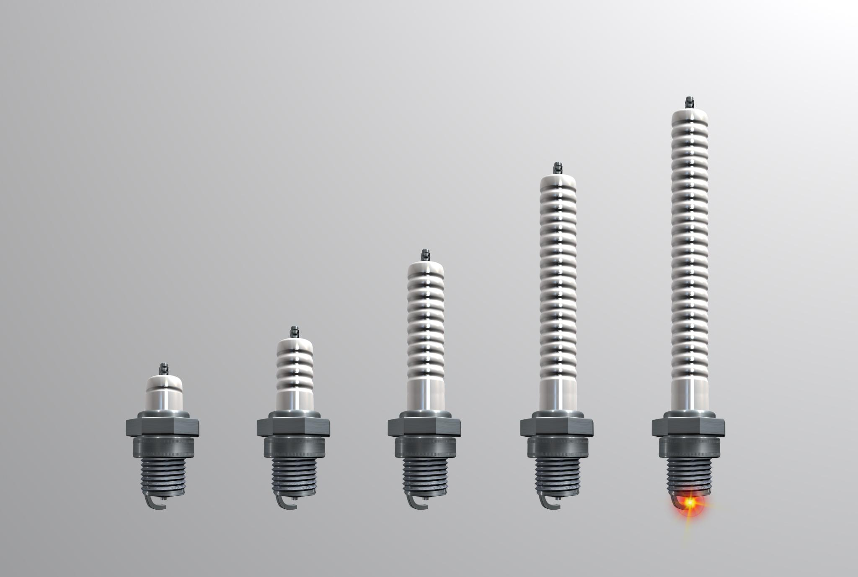
Resilience & Reliability: Shock Absorbers and Circuit Breakers
Designing for Failure
Resilience involves designing systems to handle failures gracefully and recover smoothly.
Resilience Techniques
Key techniques include retries, Dead Letter Queues, idempotency, timeouts, and circuit breakers.
Role of Shock Absorbers and Circuit Breakers
They act as buffers in architecture to ensure stability in unpredictable environments.
Avoiding Blind Retries
Blind retries can cause retry storms, leading to cascading failures in systems.
Notes:
Introduction: Next, let’s discuss Resilience and Reliability. In serverless, we cannot assume everything will always work perfectly. Services fail, networks hiccup, and dependencies slow down. The key is not to prevent every failure, but to design systems that can recover gracefully.
Designing for Failure: Resilience means expecting failure and building in safeguards. Just like cars have shock absorbers to smooth out bumps, our architecture needs mechanisms to absorb and recover from disruptions.
Core Techniques There are several proven techniques we should apply:
Retries and Dead Letter Queues (DLQs): So transient errors do not cause data loss, and failed messages can be captured for latter analysis.
Idempotency: Ensure that if a function runs more than once, it will not cause duplicate side effects.
Timeouts and Circuit Breakers: These present cascading failures by cutting off unhealthy dependencies and allowing fallback paths.
Why It Matters: Small issues can snowball into major outages without these safeguards. Blind retries, for example, can create retry storms that overwhelm downstream systems and make the problem worse instead of better.
Metaphor: Think of circuit breakers in your home. If there is a surge, the breaker trips to protect the wiring. In the same way, circuit breaks in software protect your system from cascading failures. Hock absorbers keep the ride smooth, even when the road isn’t.
Closing Transition: The takeaway here is that resilience is not just about avoiding failure—it is about absorbing it, containing it, and recovering quickly. By designing with retries, DLQs, idempotency, and circuit breakers, we make our serverless systems stable and trustworthy. Next, we will look at cost and performance because resilience also has to balance efficiency.

Slide 56

Cost, Performance & Governance: Meters, Stamps, and Assembly Lines
Cost Optimization and Performance
Mitigate cold starts and tune resources to optimize cost and performance, using energy meter analogies for visibility.
Governance and Compliance
Ensure governance with audit logs, versioning, and change control, symbolized by stamped approvals.
Operational Consistency
Use CI/CD pipelines and documentation to maintain consistency, like assembly lines or scaffolding in manufacturing.
Preventing Hidden Costs
Avoid shadow deployments and manual configuration errors by enforcing robust process controls.
Notes:
Introduction: Now, let’s look at three cross-cutting concerns that often go hand in hand: Cost, Performance, and Governance. These are the levers that determine whether our serverless system is not only functional but also efficient, compliant, and sustainable.
Cost & Performance: Serverless promises cost efficiency only if we manage it carefully. Cos starts, over-provisioned functions, or chatty architecture can drive up costs and hurt performance. The key is visibility—tagging resources, monitoring dashboards, and tuning memory, execution time, and concurrency. Think of it like energy meters on a wall: You need to see where the power is going to optimize usage.
Governance & Compliance: Next is governance. In regulated environments, we cannot afford shadow deployments or undocumented changes. Governance means audit trails, versioning, and change control – the equivalent of stamped approvals on a blueprint. These practices ensure we can prove compliance with standards like DRPR or HIPAA and roll back safely when needed.
Operational Consistency: Finally, consistency. Manual deployments and ad-hoc configuration changes are recipes for drift and errors. Instead, we need CI/CD pipelines, policy checks, and strong documentation. Think of it like an assembly line: repeatable, predictable, reliable. That is how we scale operations without relying on heroics.
Risks of Neglect: When these concerns are ignored, costs spiral, performance suffers, compliance risk grows, and operations become fragile. Invisible costs and shadow deployments are the anti-patterns to watch for here.
Closing Transition: The takeaway: optimize for speed and spending, enforce governance from day one, and build operational consistency into your pipelines. Together, these practices keep serverless architectures efficient, compliant, and sustainable.

Slide 57
Case Studies: Mini Blueprints From the Field in Serverless Architectures
Notes:
Up to this point, we have been discussing principles, patterns, and practices. However, concepts come alive when we see them applied in the real world. That is where case studies come in. They show us how organizations solve real challenges using these patterns and concerns and how the blueprint metaphors translate into practical solutions.
This text section will walk through a series of mini blueprints from the field. Each one highlights a specific problem, the serverless approach used to solve it, the patterns it illustrates, and the cross-cutting concerns that made it work at scale.
So let’s move from theory into practice. Let’s see how serverless is being applied across industries – from media and manufacturing to retail and healthcare – and what lessons we can take from these real-world blueprints.

Slide 58
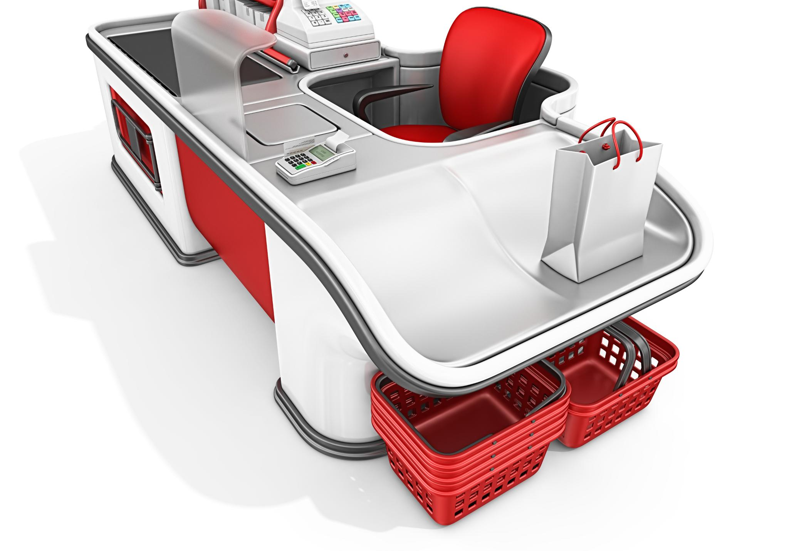
Retail E-Commerce – Flash Sale Scalability
Serverless API Gateways
Using serverless API gateways enables automatic scaling to handle traffic spikes during flash sales efficiently.
Fan-out/Fan-in Order Handling
Fan-out/fan-in mechanisms distribute and consolidate order processing to maintain system performance under peak load.
Orchestrated Workflows
Orchestrated workflows coordinate multiple services to ensure resilience and efficiency during high-volume sales events.
Notes:
Introduction / Problem: Let’s consider a retail e-commerce scenario. During flash sales, traffic can spike by 100 percent or more. Traditional APIs and monolithic backends often crumble under that sudden load, leading to failed checkouts, lost revenue, and frustrated customers.
Serverless Approach: Serverless architectures shine here because they scale automatically with demand. In this case:
An API Gateway fronts the system, routing requests to serverless functions.
Functions scale instantly to handle unpredictable bursts of traffic.
A fan-out/fan-in pattern processes orders in parallel, so thousands of orders can be handled simultaneously.
An event-driven workflow orchestrates the downstream steps – payment processing, inventory updates, and sending confirmations – without bottlenecks.
Patterns Illustrated: This case study highlights three key patterns:
API Gateway + Function for request/response handling.
Fan-Out/Fan-In for parallel order processing.
Orchestration to coordinate the sequence of payment, inventory, and confirmation.
Cross-Cutting Concerns: Two cross-cutting concerns are especially important here:
Resilience: Dead Letter Queues capture failed orders, so nothing is lost, even if a downstream service hiccups.
Cost Efficiency: Because serverless is pay-per-use, the retailer only pays for the surge in compute during the sale, not for idle capacity the rest of the time.
Metaphor/Visualization: Think of it like a checkout counter in a store. Normally, you might have two or three lanes open. Butt during a flash sale, dozens of lanes open instantly to handle the rush – and then close again when the crowd is gone. That is exactly what serverless enables.
Closing Transition: So, the takeaway here is: serverless architectures give retails the elasticity to handle massive, unpredictable spikes without over-provisioning. Next, we will look at how similar principles apply in other industries, like healthcare, where the stakes are even higher.

Slide 59

Healthcare Analytics – Real-Time Patient Monitoring
Serverless Architecture Adoption
Hospitals leverage serverless architectures for scalable, event-driven real-time patient monitoring with improved responsiveness.
Scheduled Alerts and Processing
Scheduled events and alerts enable timely responses to patient conditions through cron-like job scheduling.
Secure Data Lake Integration
Data lakes securely collect and store patient data, enabling analytics while ensuring privacy and observability
Notes:
Introduction / Problem: In healthcare, seconds matter. Hospitals rely on IoT devices—heart rate monitors, oxygen sensors, and more—to track patient vitals in real time. The challenge is processing all of that data instantly and reliably so alerts can be issued the moment something crosses a critical threshold.
Serverless Approach: This is where serverless architecture shine. In this case:
IoT signals are ingested through Event Hubs or Kinesis, providing a scalable entry point for continuous data streams.
Functions process and enrich the data real time, filtering noise and highlighting what matters.
When thresholds are crossed, alerts are triggered immediately, notifying clinicians.
At the same time, all data is stored in a secure data lake, ensuring it’s analytics-ready for compliance reporting and long-term insights.
Patterns Illustrated: This solution demonstrates several essential patterns:
Event-Driven Processing to handle the constant flow of IoT signals.
Data Lake Integration for secure, analytics-ready storage.
Scheduler/Cron to generate periodic compliance reports automatically.
Cross-Cutting Concerns: Two cross-cutting concerns are especially critical here:
Security & Identity: With HIPAA and other regulations, least-privilege access and strong identity controls are non-negotiable.
Observability: Tracing across devices and functions ensures that engineers can quickly pinpoint the issue if something goes wrong.
Metaphor/Visualization: Think of it like a hospital ward where every patient has sensors feeding into a central monitoring station. Doctors and nurses do not have to check each patient manually – the system highlights issues in real time, ensuring faster, safer care.
Closing Transition: So, the key takeaway here is: serverless enables healthcare providers to process massive streams of patient data in real time, while staying secure and compliant. It is a powerful example of how these patterns and concerns translate into life-saving outcomes. Next, we will look at two actual real-world uses of serverless architectures.

Slide 60

S&S Media – Automated Slide Extraction From Video
Event-Driven Processing
S&S Media utilizes serverless event-driven processing for frame-by-frame video analysis.
Automated Slide Extraction
The system automatically extracts slides from speaker videos, preventing missing conference content.
Observability and Cost Control
Cross-cutting concerns include managing operational costs efficiently.
Blueprint Metaphor
The blueprint metaphor illustrates a film reel feeding into a slide projector for automated content delivery.
Notes:
Introduction / Problem: One of the recurring frustrations at conferences is that speakers do not always submit their slides on time. However, attendees expect to find those decks in the conference app right after the talk. This creates a gap between what organizers can deliver and what participants expect.
Serverless Approach: S&S Media solves this problem by turning to serverless. When speakers do not upload their decks, S&S can process the video recordings themselves.
Video streams are fed into serverless compute functions like AWS Lambda or Azure Functions.
A frame-by-frame analysis detects when a slide changes.
Those frames are extracted, compiled into a slide deck, and automatically published to the conference app.
Patterns Illustrated: This solution demonstrates two critical patterns:
Event-Driven Processing: Each video frame becomes an event that triggers analysis.
Data Processing Pipeline: The workflow moves from extraction to transformation to publishing, all in a seamless flow.
Cross-Cutting Concerns: To make this work at scale, two cross-cutting concerns were critical:
Observability: Monitoring the accuracy of slide extraction so organizers can trust the output.
Cost Control: Because serverless scales with video load, they only pay for compute when videos are being processed, not for idle infrastructure.
Metaphor / Visualization: Think of it like a film reel feeding into a slide projector. The video itself becomes the source of truth, and the system automatically projects the slides out for attendees—no manual intervention required.
Closing Transition: So, the takeaway here is: by combining event-driven processing with a data pipeline, S&S Media turned a logistical headache into an automated, scalable solution. Next, we’ll see how similar principles apply in manufacturing, where vent-driven ERP systems are reshaping traditional workflows.

Slide 61

Jasper Engines & Transmissions – Event-Driven ERP for Remanufacturing
Event-Driven Architecture
Jasper Engines implemented event-driven architecture using event sourcing and CQRS to enhance remanufacturing ERP.
Legacy System Replacement
The new ERP replaced legacy systems to improve operational consistency and governance in remanufacturing processes.
Serverless Integration
Serverless technologies enabled flexible integration and compliance across modular process automation stations.
Real-Time Workflow Tracking
Real-time tracking of events on the assembly line improves remanufacturing workflows and process automation.
Notes:
Introduction / Problem: Let’s shift to the remanufacturing world. Jasper Engines & Transmissions faced a common challenge in specialized industries: their legacy ERP systems did an adequate job tracking manufacturing data. Jasper requires tracking of every part through inspection, machining, and assembly – and legacy systems were not built for that level of granularity.
Serverless Approach: To solve this, Jasper is building a custom, event-driven ERP system powered by serverless functions and serverless containers.
Each function handles a discrete manufacturing event – whether that’s an inspection, a machining step, or final assembly.
Using event sourcing, they capture a complete history of every part and process, ensuring full traceability.
This modular, event-driven approach gave them the flexibility to adapt workflows without the rigidity of a monolithic ERP.
Patterns Illustrated: This case study highlights three important patterns:
Event Sourcing: Maintaining a full, immutable history of remanufacturing steps.
CQRS: Separating operational queries from report queries so that the system can scale efficiently.
Strangler Fig: Incrementally migrating away from the legacy ERP, replacing it piece by piece with modern serverless components.
Cross-Cutting Concerns: Two cross-cutting concerns were especially critical here:
Governance & Compliance: Audit-ready even logs ensure every step in the process is documented and compliant.
Operational Consistency: Matrix-driven pipelines standardize deployments, reducing the risk of errors in such a complex environment.
Metaphor / Visualization: It is like an assembly line blueprint with event “stations.” Each station represents a discrete event in the process, forming a complete, traceable workflow. That is precisely how Jasper reimagined ERP for remanufacturing.
Closing Transition: The key takeaway here is: by embracing event-driven design, Jasper Engines transformed a rigid legacy ERP into a flexible, auditable, and scalable system.

Slide 62
Transition to Interactive Workshop: From Blueprints to Practice
Notes:
Up until now, this has been mostly a presentation—me walking through the blueprint. But blueprints are not meant to stay on paper. They are meant to be used, tested, and adapted. So now, we are going to shift gears into the interactive part of the day.
Think of this as moving from the lecture hall into the design studio. Each of you will get the chance to apply what we have covered to real-world scenarios. You will work in small groups, sketching out your own blueprint pages, making trade-offs, and deciding which patterns fit, which pitfalls to avoid, and which cross-cutting concerns to prioritize.

Slide 63

Blueprint Index Recap: Toolboxes & Takeaways
Comprehensive Summary
The recap visually summarizes core patterns, anti-patterns, cross-cutting concerns, and case studies for clarity.
Architectural Toolbox
Participants have built a comprehensive set of architectural tools to support design and development.
Transition to Creation
This recap sets the stage for moving from planning to active creation in the workshop environment.
Notes:
This section offers a clear visual summary of all the major sections covered so far—core patterns, anti-patterns, cross-cutting concerns, and real-world case studies. The recap emphasizes that participants have built a comprehensive architectural toolbox, setting the metaphorical stage for moving from planning to active creation in the workshop.

Slide 64

Collaboration Setup: From Lecture Hall to Design Studio
Active Participation
Transition from passive learning to active engagement fosters deeper understanding and skill development.
Scenario-Driven Exercises
Using realistic scenarios helps apply serverless principles in practical and relevant contexts.
Collaborative Diagramming
Diagramming together enhances visualization and problem solving in a dynamic, studio-like environment.
Notes:
Here, the presentation explains the transition from passive learning to active participation. Attendees are introduced to the small-group format, scenario-driven exercises, and collaborative diagramming. The focus is on experimentation and applying serverless principles in practical settings, mirroring the dynamic environment of a design studio.

Slide 65

Scenario Framing: Blueprinting Real-World Problems
Scenario-Based Challenges
Two design challenges use real-world scenarios framed as blueprint problem statements to guide decision-making.
Critical Evaluation
Teams evaluate patterns, anti-patterns, and cross-cutting concerns relevant to each challenge for effective solutions.
Cloud-Native Trade-Offs
Participants are encouraged to analyze trade-offs in cloud-native design to develop balanced, practical solutions.
Notes:
Two scenario-based design challenges are introduced as the next step. Each challenge is framed as a blueprint-style problem statement with specific constraints, encouraging teams to decide which patterns, anti-patterns, and cross-cutting concerns are most relevant. This primes participants to think critically about trade-offs in cloud-native design.

Slide 66

No Single Correct Answer
Notes:
To boost engagement, this slide calls participants to action: it’s their turn to become the architects, applying learned concepts to build solutions. The messaging underscores that there’s no single correct answer, and that thoughtful reasoning and collaboration are key. The visual metaphor shifts from blueprints to drafting tables, symbolizing hands-on design.

